Slide 1
2N IP Intercoms Secure, reliable, futureproof

Slide 2
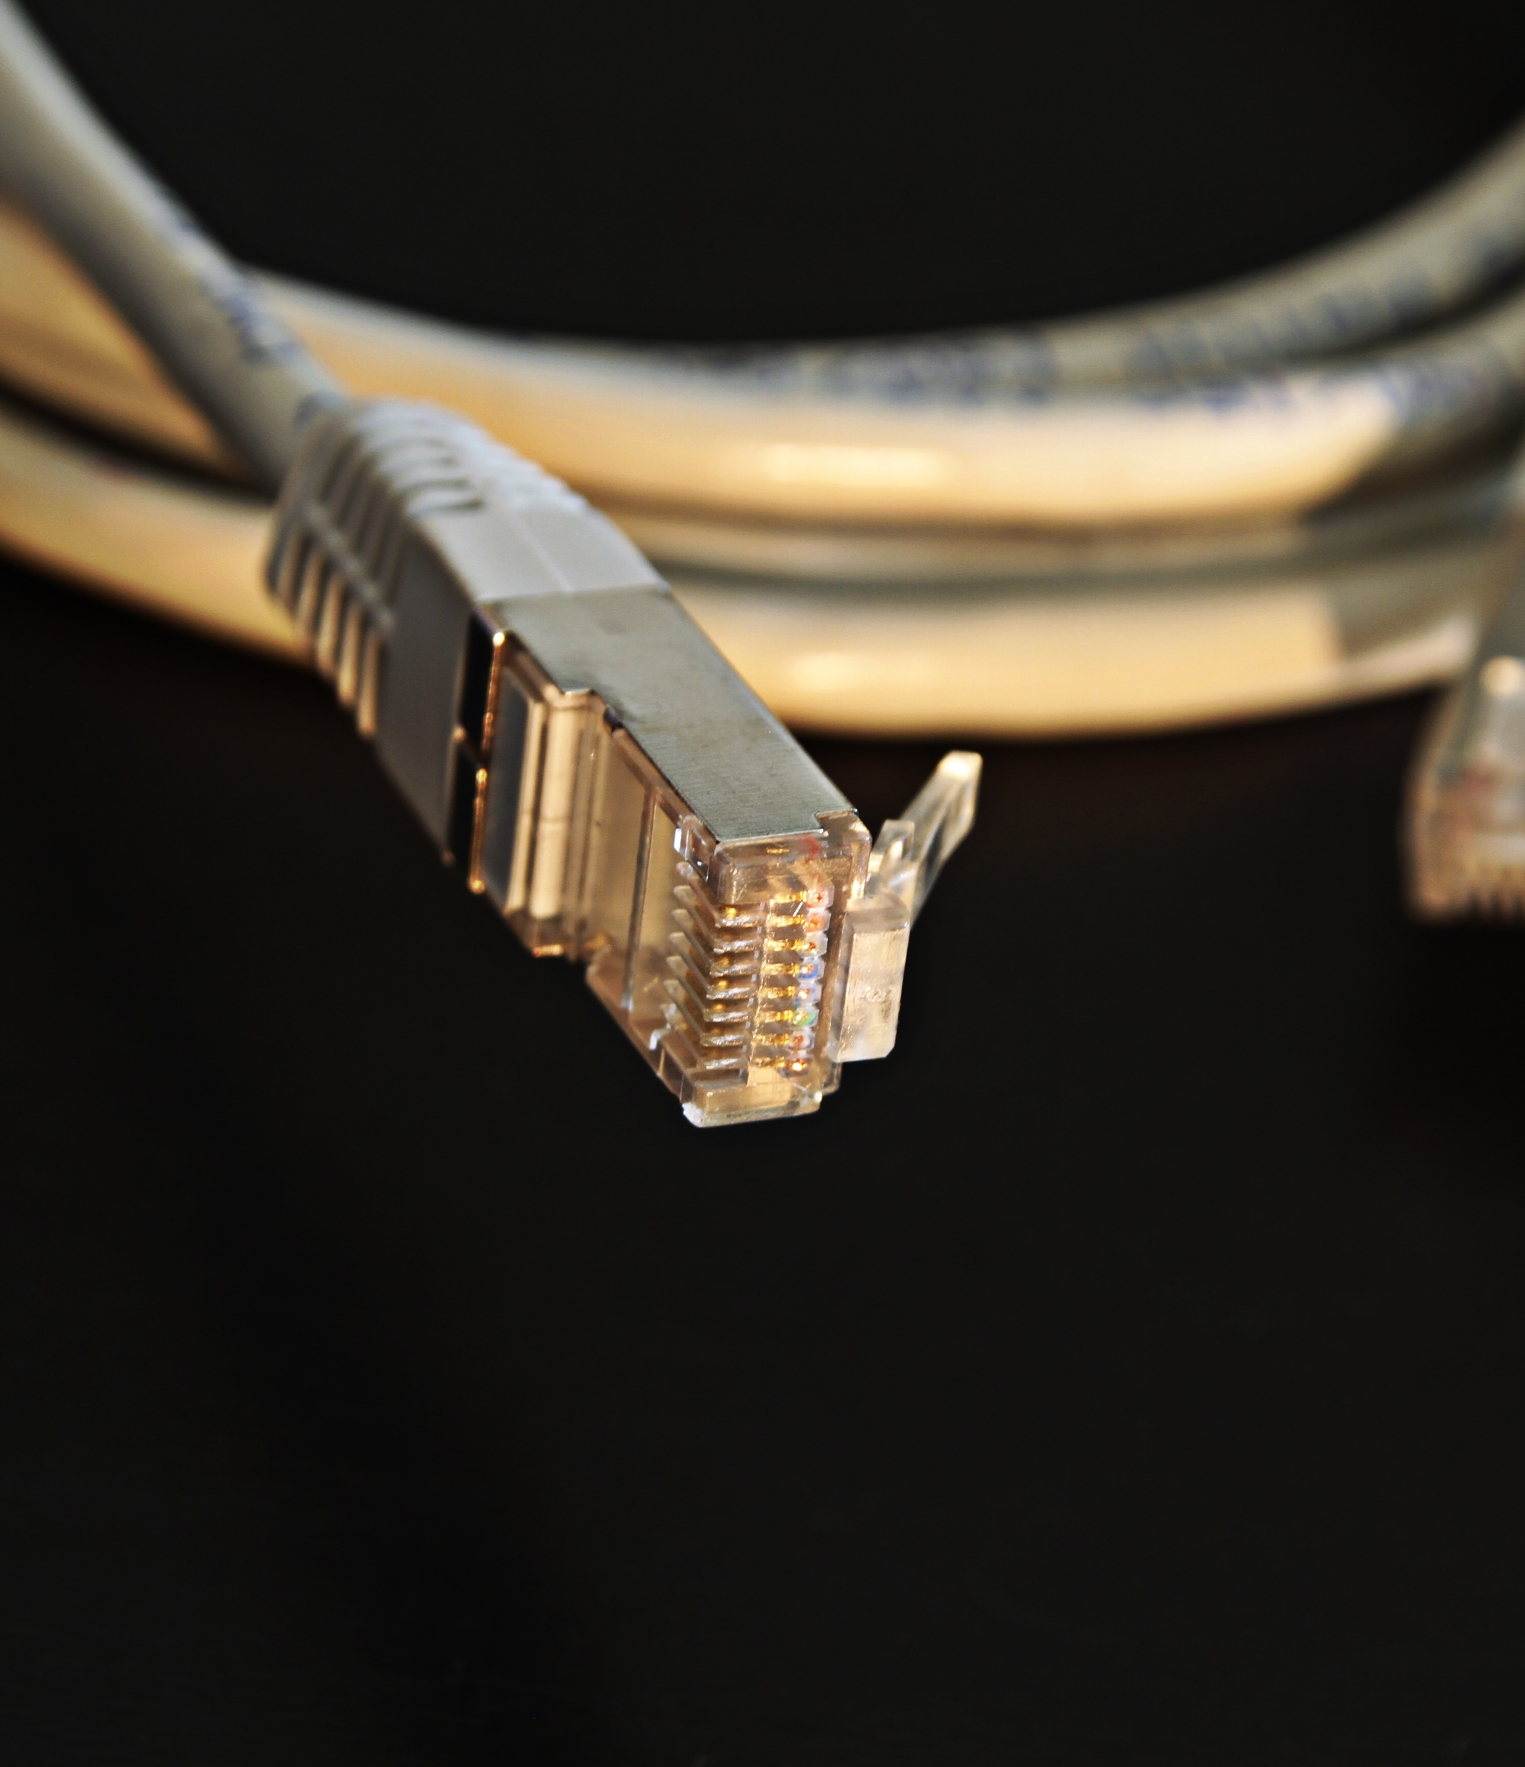
Why choose IP?
Use of common network infrastructure
Seamless integration with other systems
Advanced features
Easy maintenance and updates
Long-term cost-effectiveness
Investment protection

Slide 3


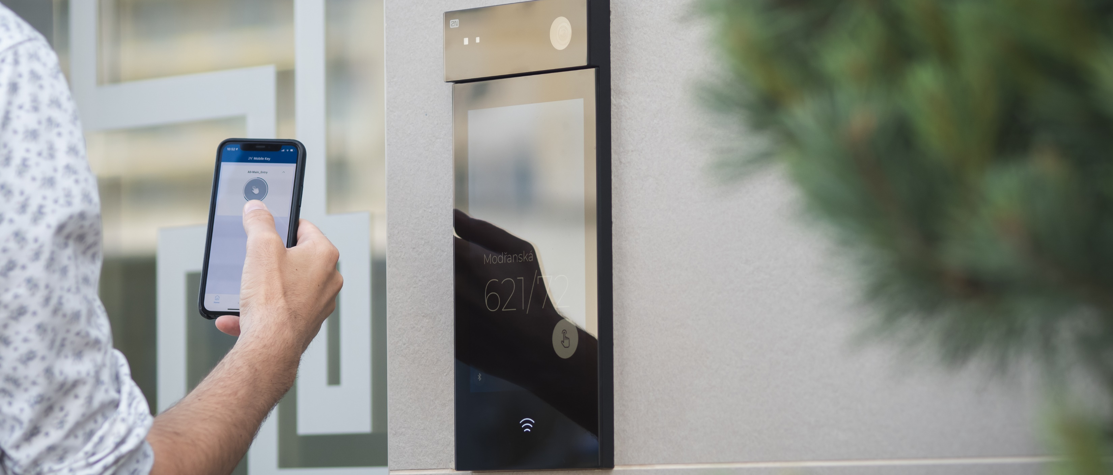
IP benefits over 2-wire networks: in detail
Use of common infrastructure
IP devices communicate over a local area network (LAN), a common infrastructure found in most homes and businesses.
2-wire systems require dedicated wiring, which limits power, distance and the number of devices.
Easy integration
IP systems can integrate seamlessly with other devices and systems, such as access control, security cameras, smart homes, and building management systems.
2-wire systems use closed protocols, so they require specialized development for every integration.
Advanced features
IP systems offer a wide range of advanced features, including motion detection, video analytics, cloud storage, automation, and software-based control.
2-wire intercom systems have basic features with minimal potential for adding additional functions.

Slide 4



IP benefits over 2-wire networks: in detail
Easy maintenance and updates
IP-based systems can be remotely maintained, updated and configured, reducing the need for on-site maintenance.
2-wire systems require physical access to the system, making it more time-consuming and costly.
Long-term cost-effectiveness
Fewer cables and maintenance requirements, plus easier upgrades = lower overall costs, despite the more expensive installation.
2-wire systems may be cheaper initially, but wiring and hardware limitations mean that upgrading the system can increase costs.
Investment protection
Unlike 2-wire systems, IP continues to deliver.
With continuous new firmware releases, IP systems offer a future-proof solution.
Projects can get enhanced new features and security patches, without additional costs.

Slide 5

Why choose 2N?
Your building deserves high-quality door control
Choose from a range of IP intercoms from an industry leader that prioritizes reliability and innovation

Slide 6
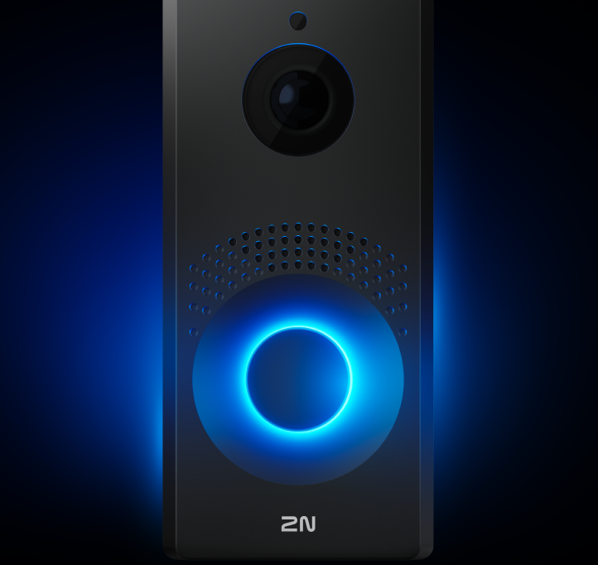


Meet the needs of any project
Integrate without limits
Get multifunctional devices
We build our devices on open protocols, partner with over 200 leading brands, and make easy integration a priority
Combine audio, video, and a reader in a single device that also supports several access methods
You need flexibility, and we have a wide range of flexible devices that suit every vertical

Slide 7



For new builds & retrofits
Prioritize cybersecurity
Rely on true innovators
An ISO 27001-certified company, cybersecurity is our priority. We design intercoms based on proven security models such as Axis' ASDM
Collaborate with the company that launched the world’s first IP intercom – and that’s kept innovating ever since
Advanced intercoms that are the perfect fit for modern newbuilds – but also work in retrofit projects with tricky cabling requirements.

Slide 8
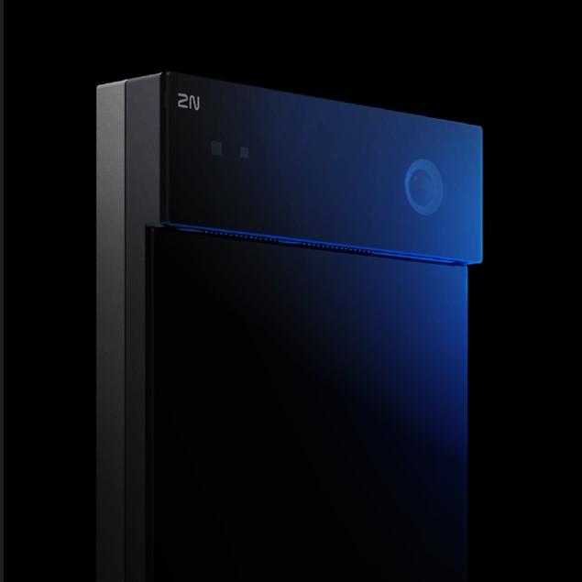


European quality
5-year warranty
No need for SIP servers
2N IP intercoms work as standalone devices and support direct SIP calls
Designed and manufactured in Europe using high-quality components, with strong reliability in mind
Our intercoms are Built to Last. The 5-year warranty, standard on all hardware, reflects our commitment to high-quality, reliable tech

Slide 9

Meet new cybersecurity requirements
Secure boot: SW authenticity verified by HW from 2N production
Secure storage: All data encrypted (config, directory, certificates)
Signed firmware: Only 2N-signed OS accepted
Password policy: Forced change during setup
No extra interfaces: Production interfaces disabled post-setup
Secure communication: HTTPS, SIPS, SRTP, TLS 1.2, 112+ bit keys
No known vulnerabilities: Aligned with 2N R&D and vulnerability policies

Slide 10
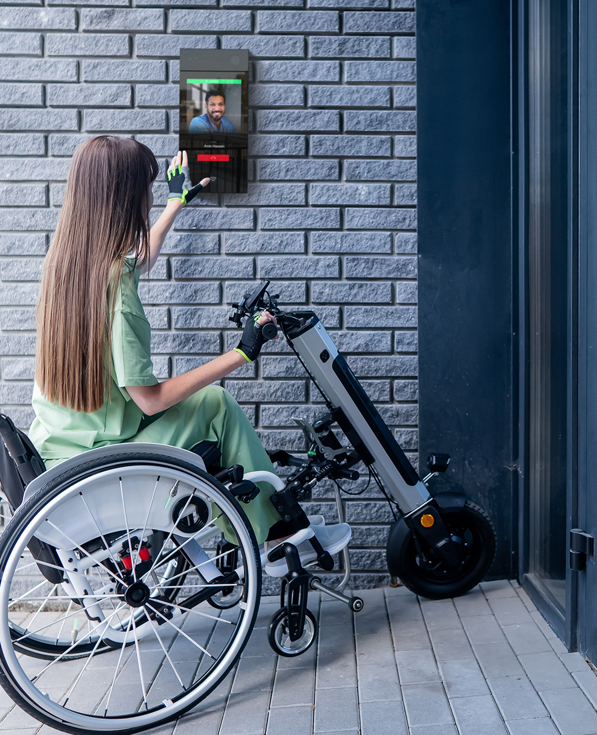
Ensuring access & motion. For all.
Compliant with the European Accessibility Act
High-quality audio & visuals over VoIP
Create an accessible intercom screen with our custom GUI builder on the 2N IP Style
Pictograms: intercom state signals that guide deaf users
Induction loops for users of hearing aids
Audio prompts & navigation for blind & visually impaired users
Adaptive face-zooming ensures visibility of wheelchair users in a wide-angle shots

Slide 11








Intercoms that secure any entrance
Apartment buildings
Single-family homes
Offices & mixed-use buildings
Hospitality
Industrial sites
Healthcare & education
Notes:
More in-depth?

Slide 12

Intercoms ready for easy integration
SIP
HTTP API
ONVIF
RTSP/RTP
Plugins
RIO
Wiegand
www.2n.com
Notes:
* Old graphic

Slide 13

The 2N portfolio

Slide 14
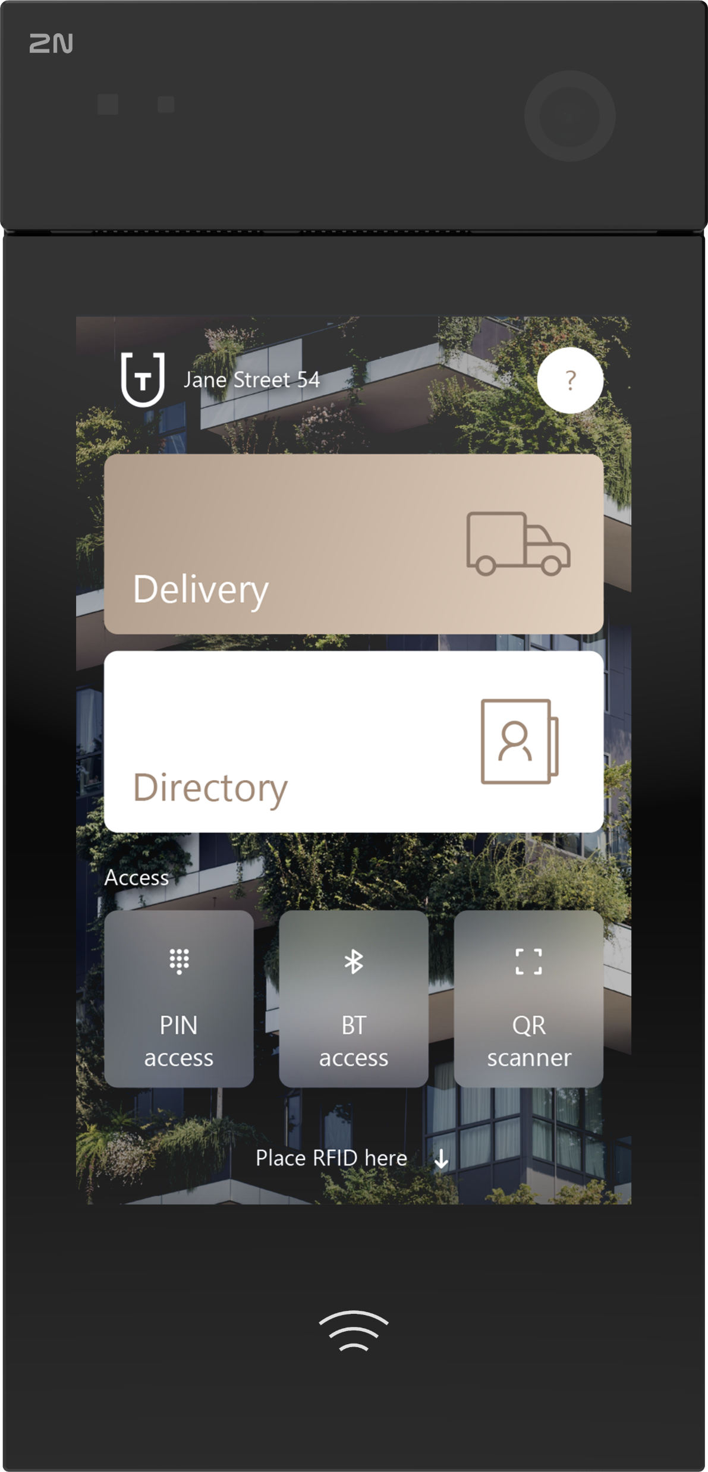
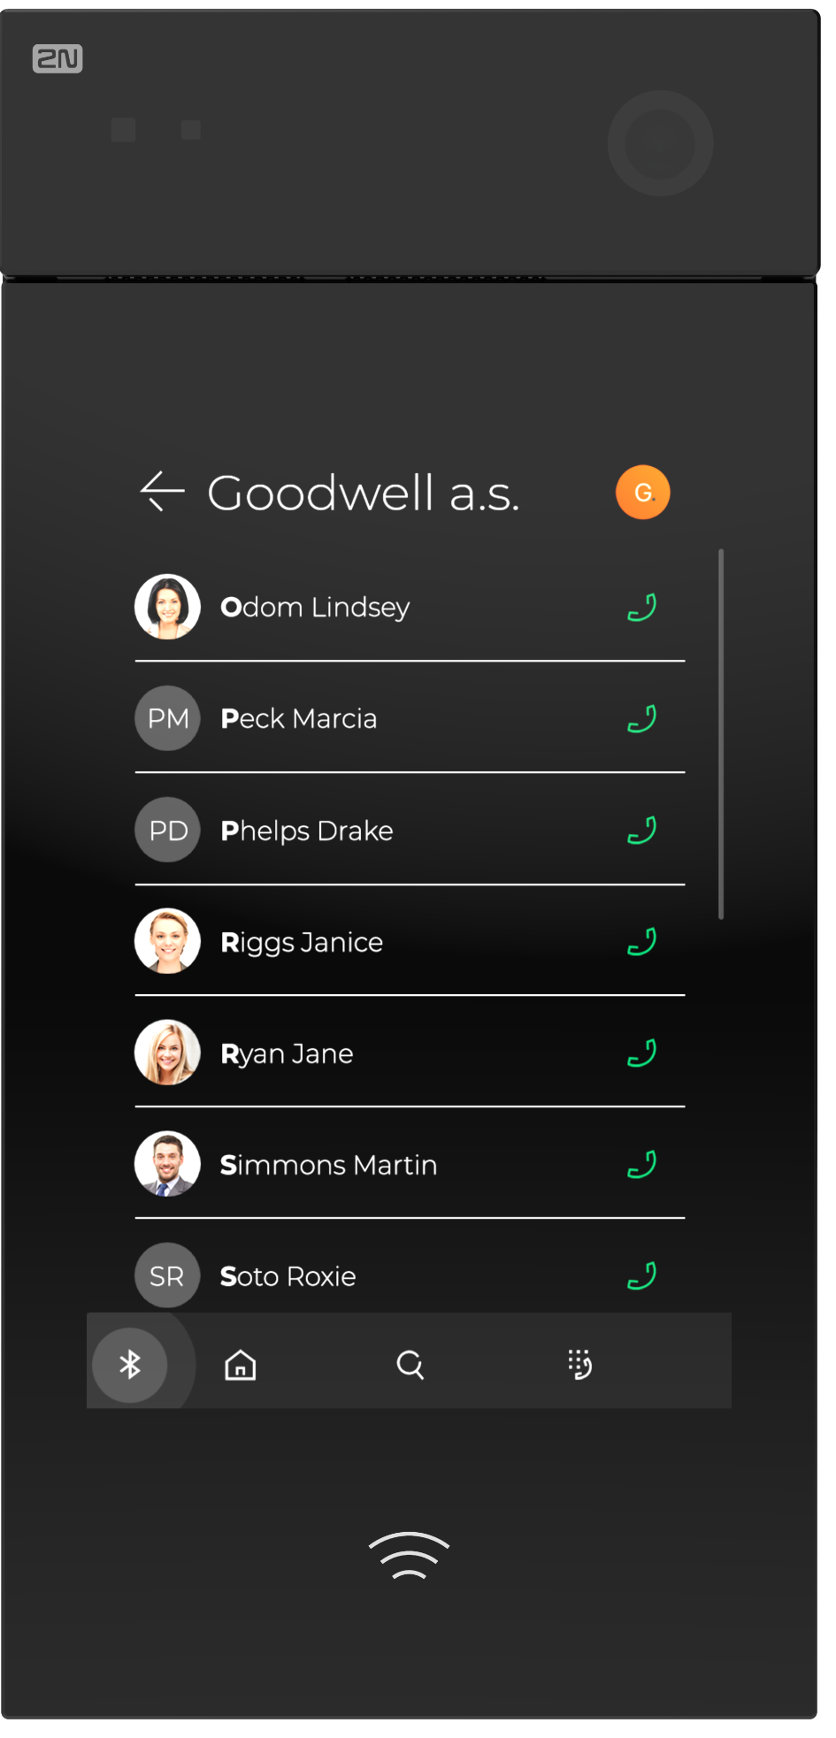
2N IP Style
Defining future standards for video intercoms
Notes:
RED Badge?

Slide 15


Slide 16
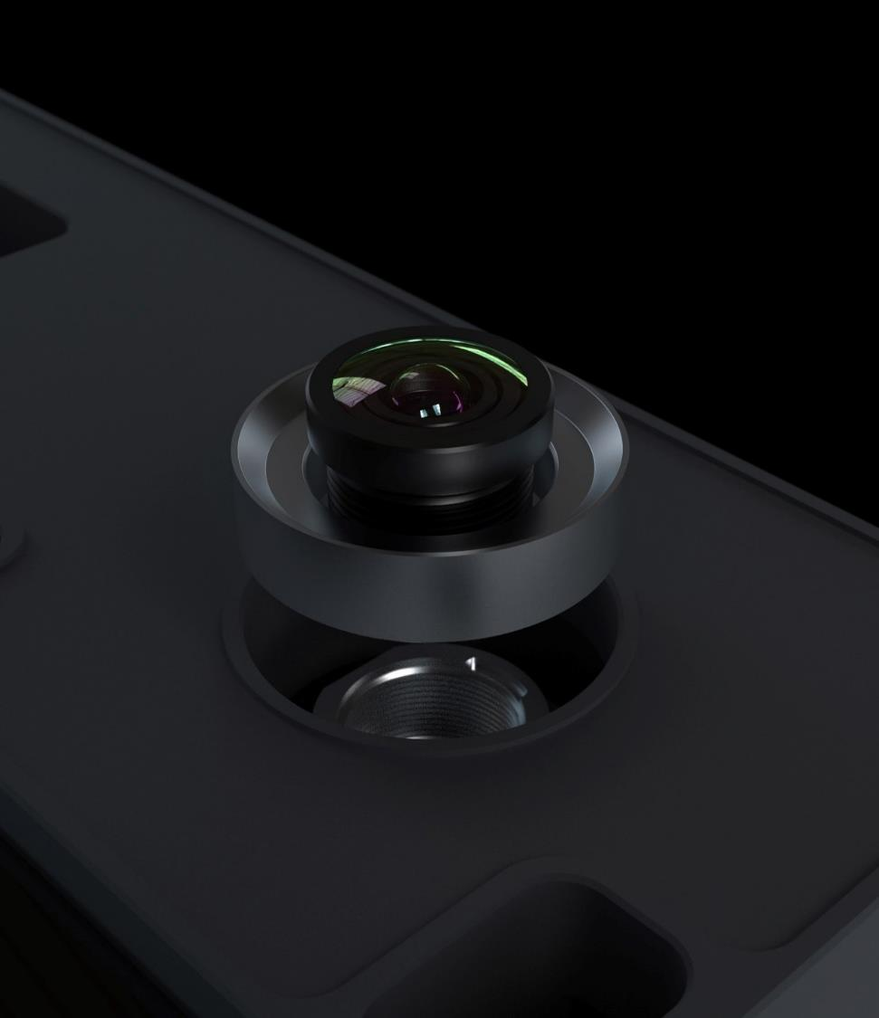
2N IP Style features
The camera of the future
Enhance your projects with an intercom that can handle multiple simultaneous Full HD streams and has a 5 MPx chip.
It supports WDR and provides clear colour images, even in low-light conditions.
Adaptive Face Zooming enhances the wide-angle lens for crystal clear visitor verification.

Slide 17
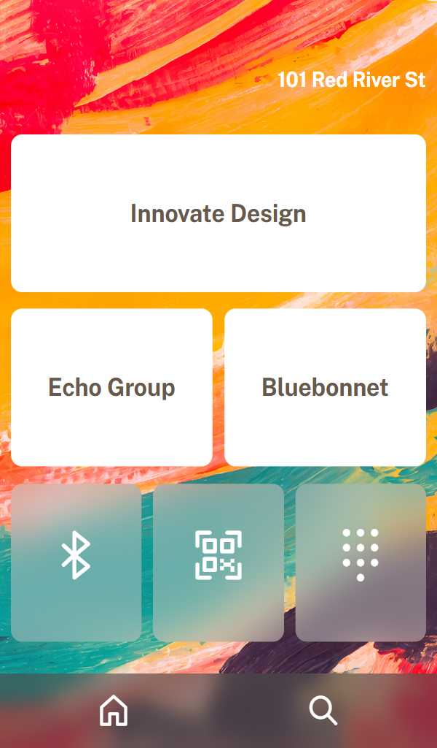
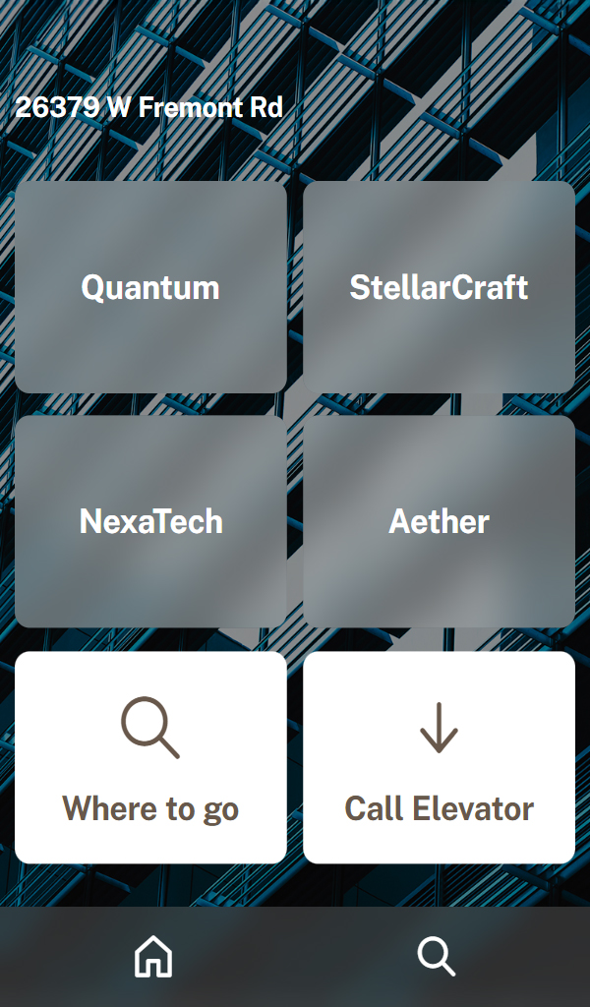
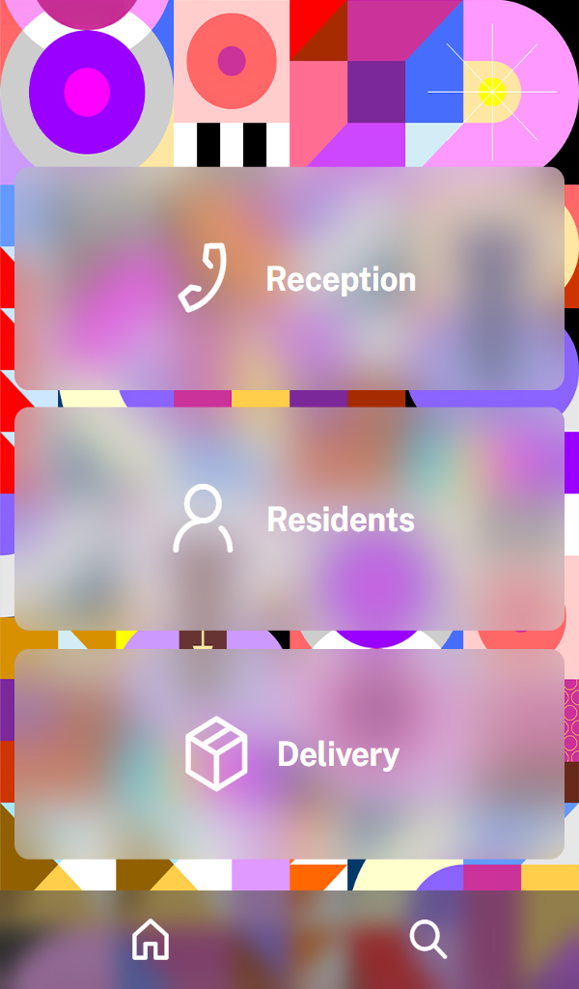
2N IP Style features
A customisable display
2N Flexi Layout allows you to craft a completely custom intercom screen to meet the needs of any customer.
Create personalized homepages, display videos, add custom buttons with useful required actions, and more.

Slide 18
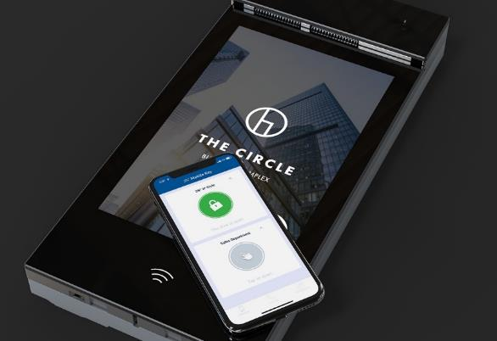
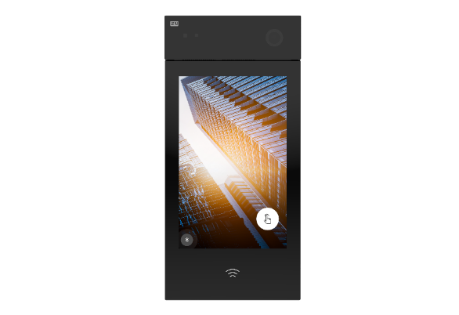
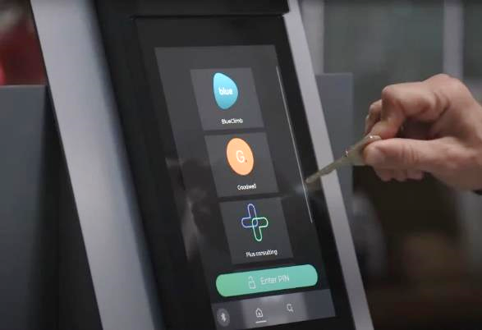




2N IP Style features
Modern, versatile access
Offer smooth, secure, and reliable access to buildings. Choose from mobile access, QR codes, PIN, and RFID – all in one device
Premium 10“ display
The extreme brightness of the display guarantees excellent readability, even in direct sunlight.
IP65 and IK08 durability
The 2N IP Style can easily resist heavy rain, a dusty environment, and even attacks by vandals.
Notes:
Order numbers - sitelink

Slide 19
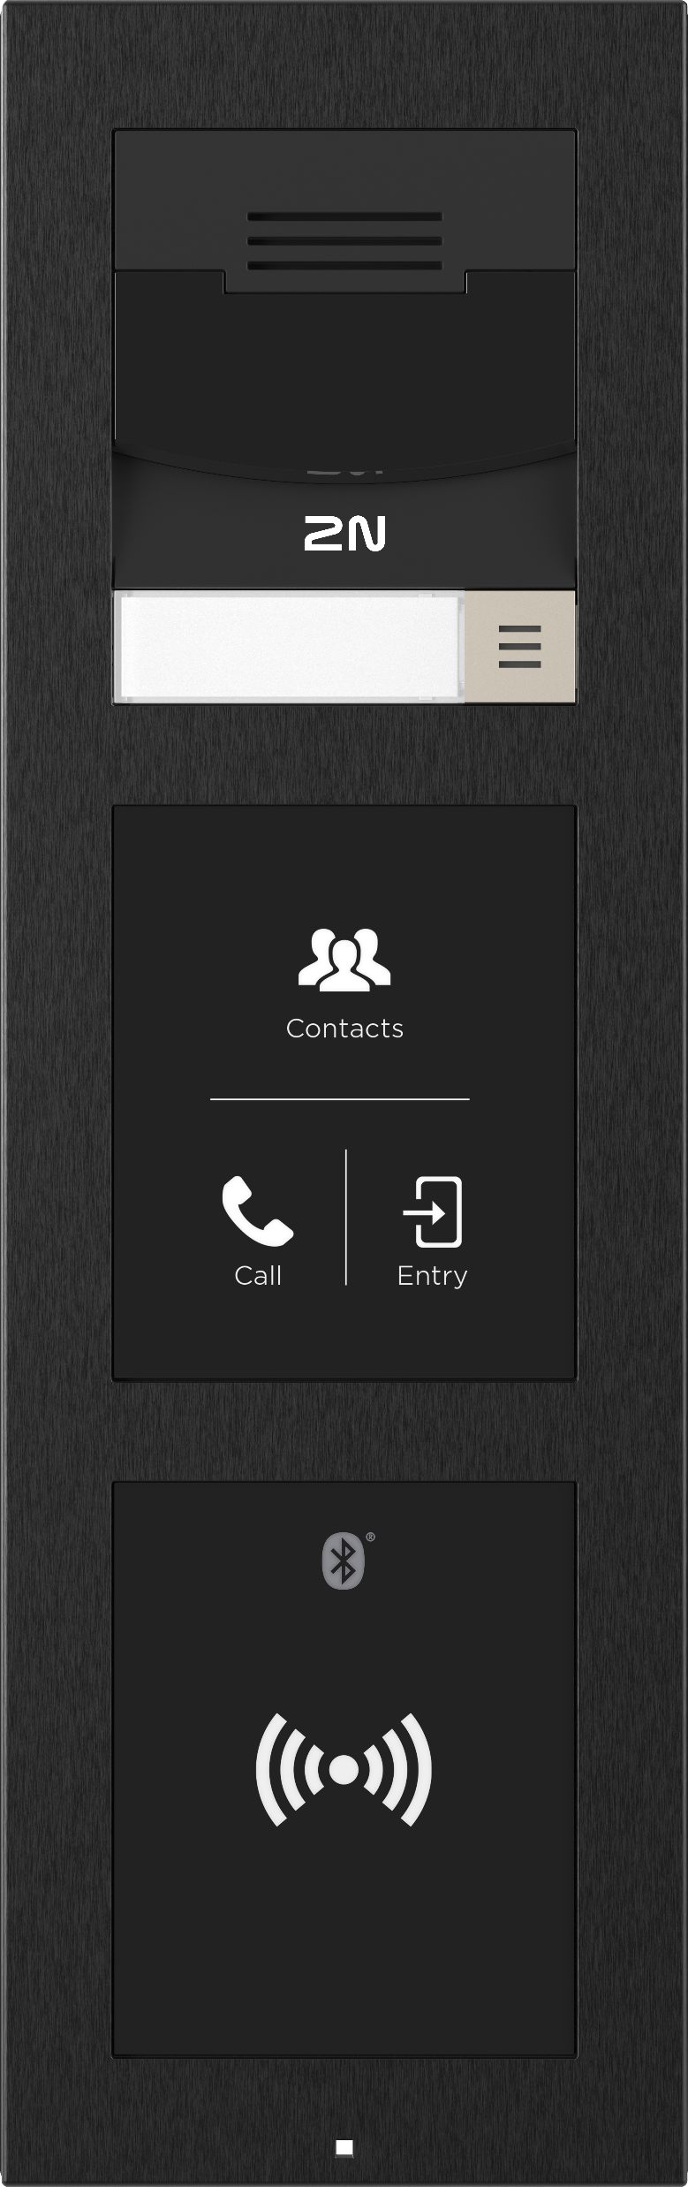
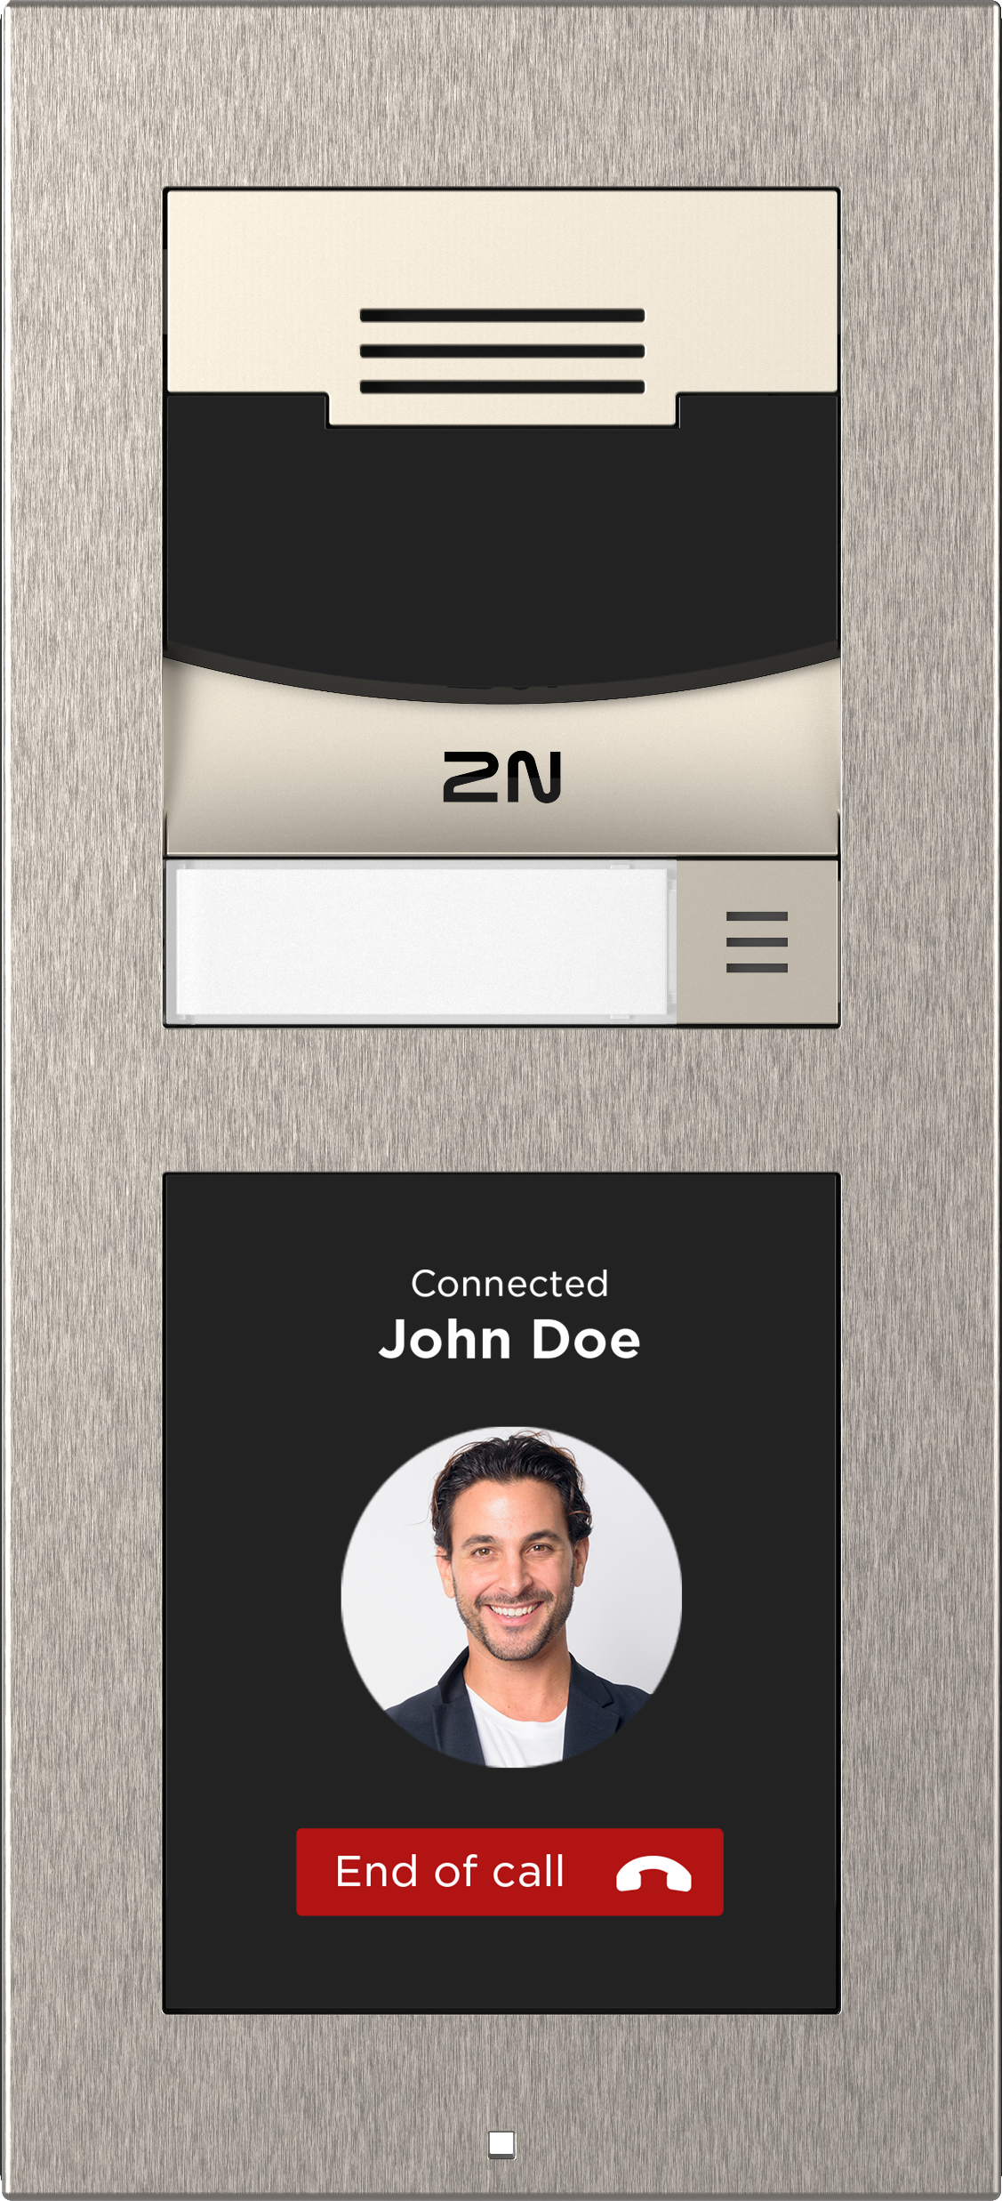
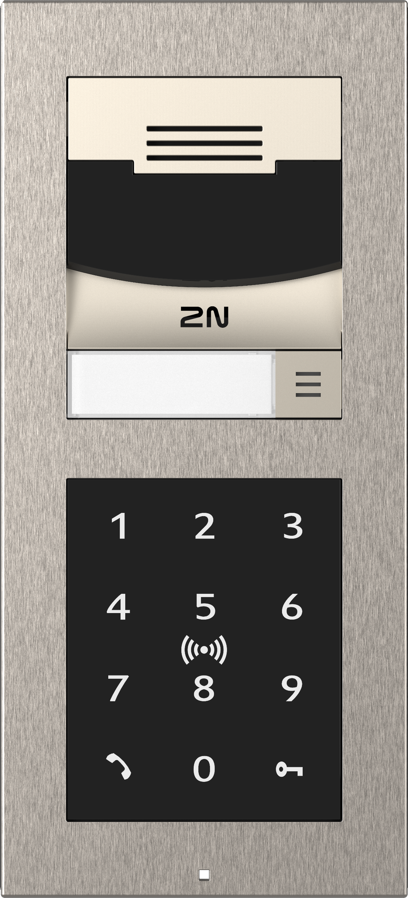
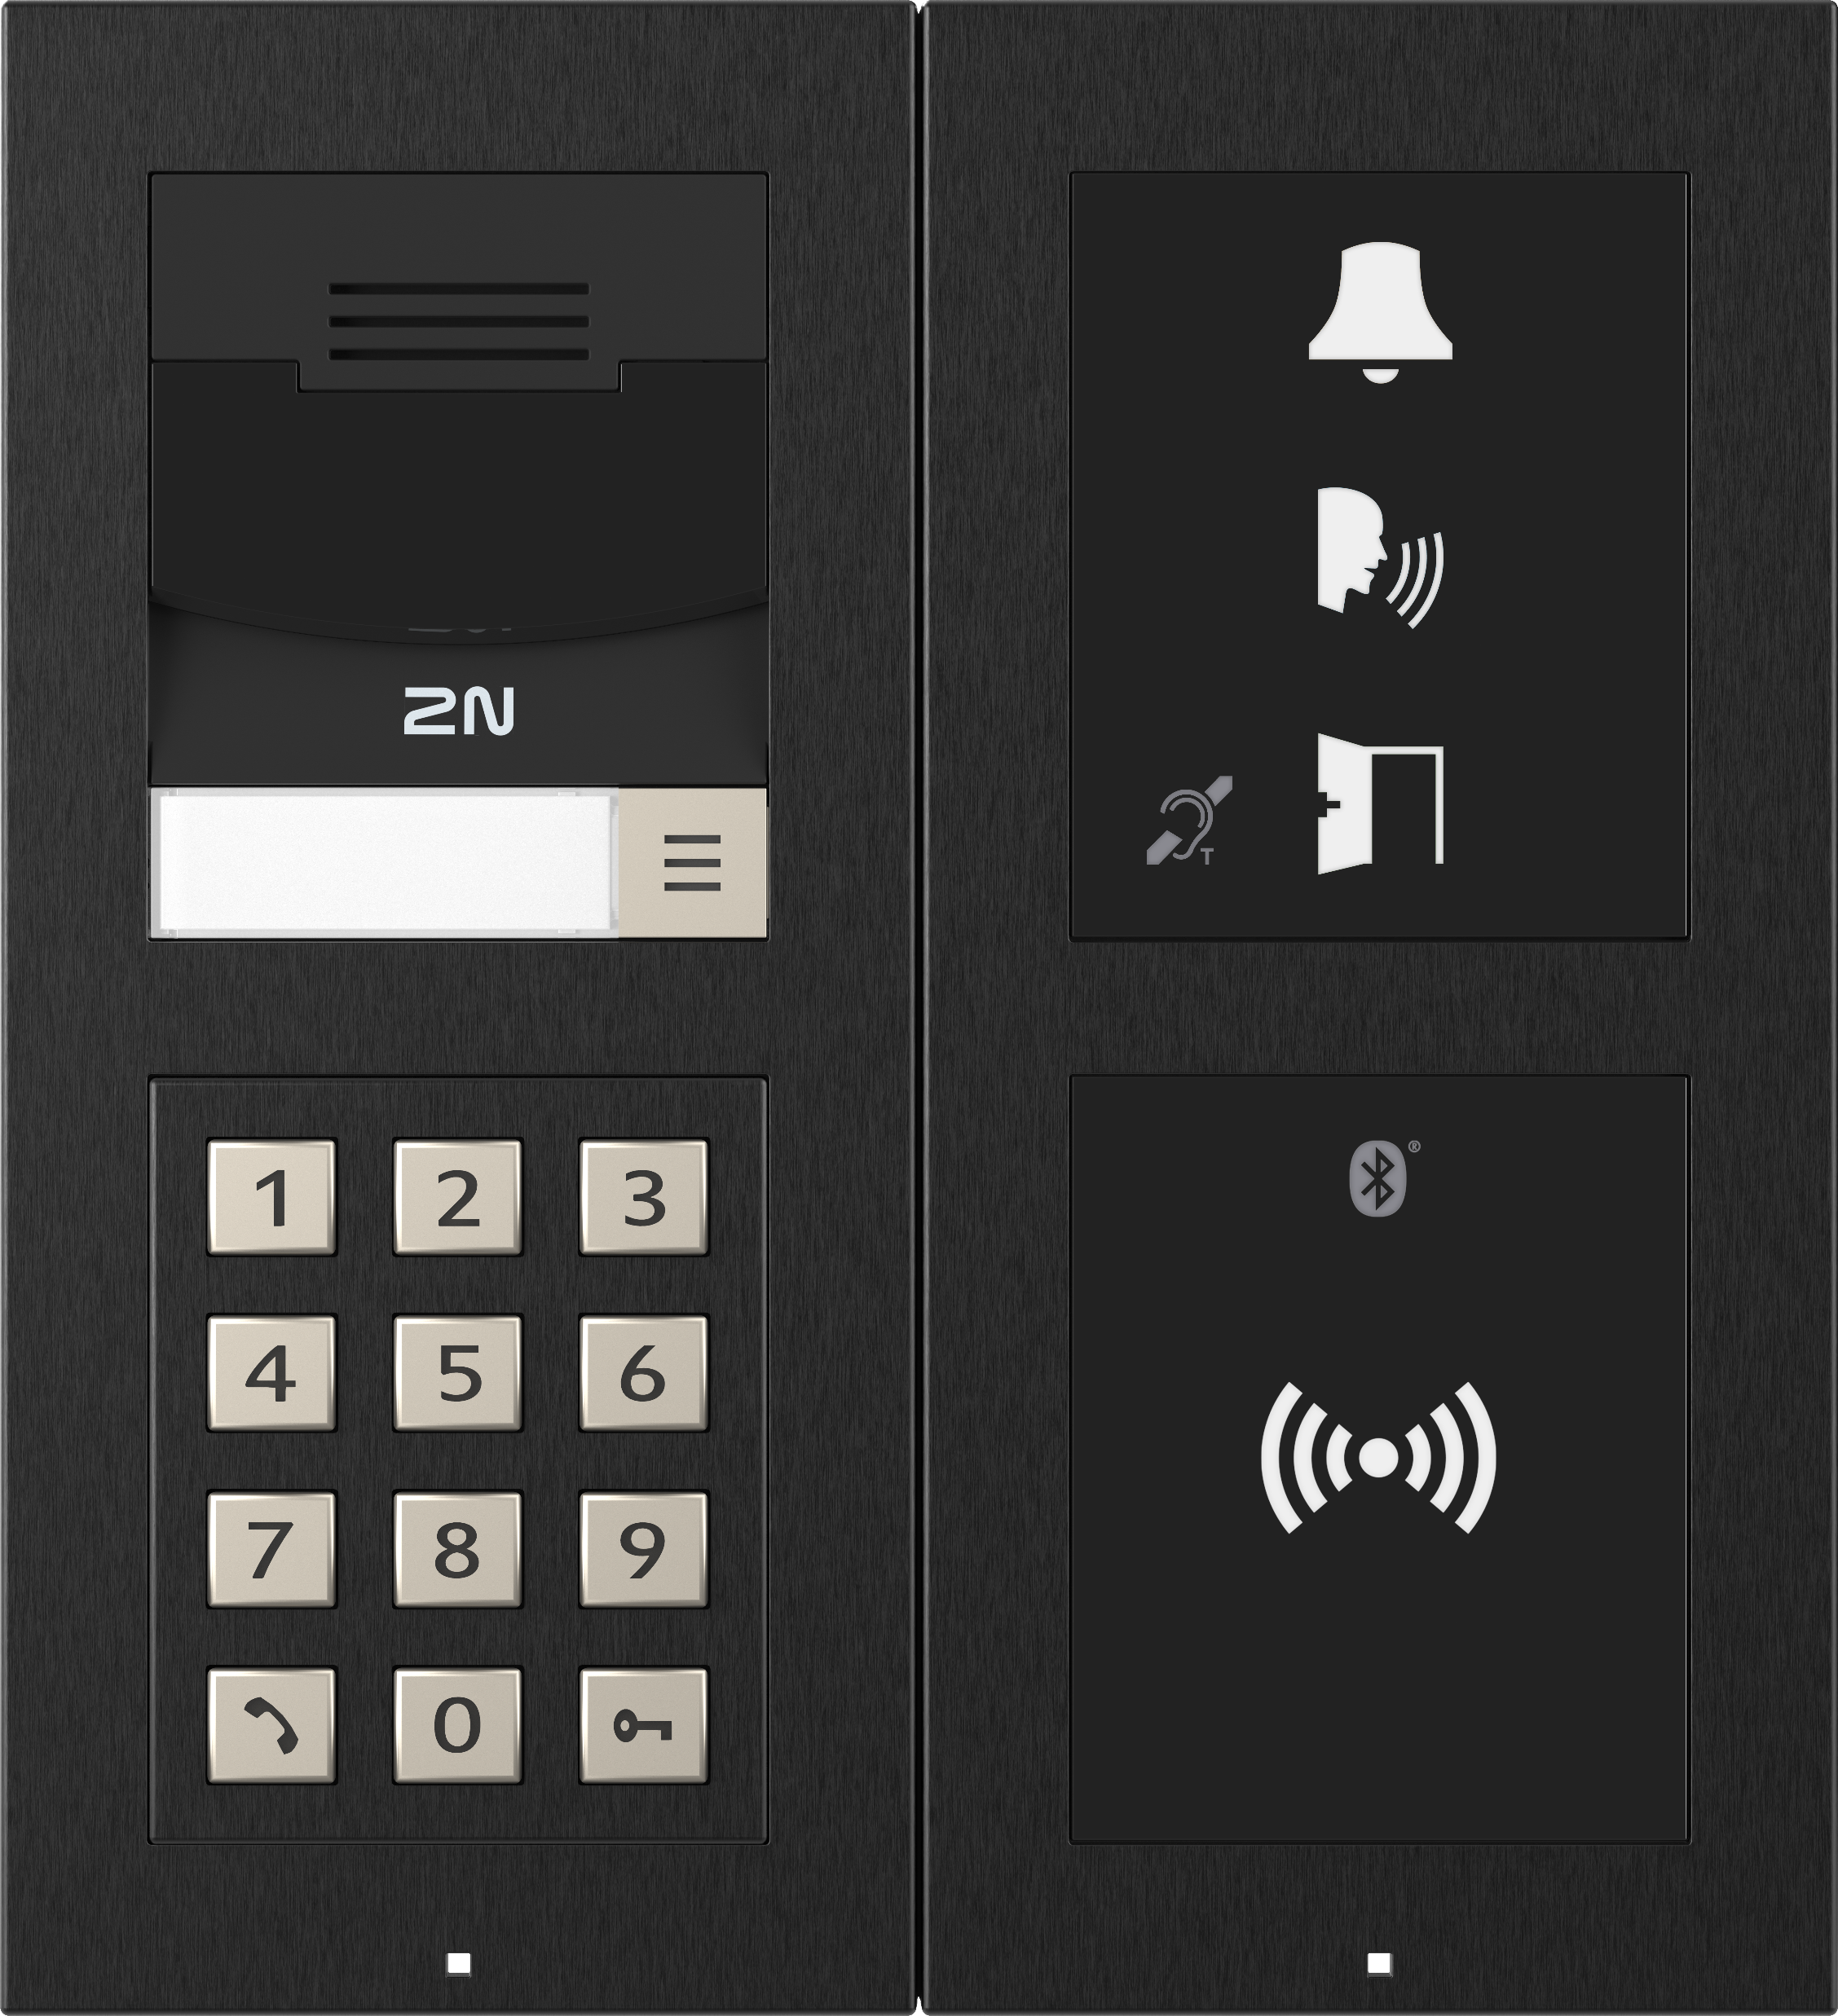
2N IP Verso 2.0
Create an intercom for any project imaginable

Slide 20


Slide 21
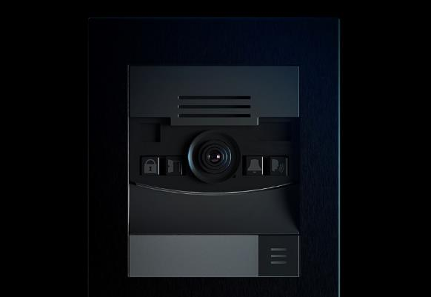
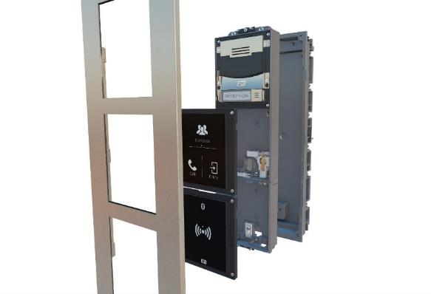
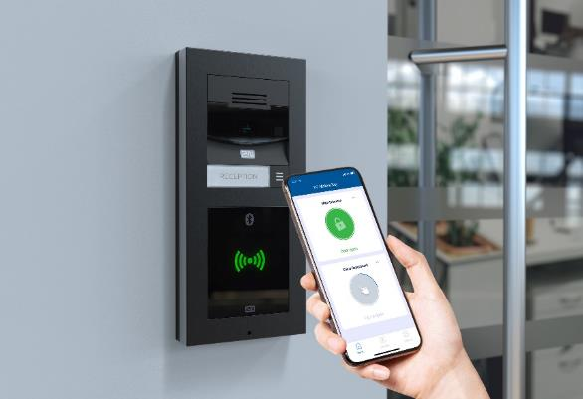



2N IP Verso 2.0 features
Wide-Angle Full HD Camera
It provides crystal-clear colour images, supports WDR, and maintains image colour even in low light conditions.
Advanced Modularity
Combine 16 different modules and 4 installation options to create the ideal intercom for your project.
Choose any Access Control Option
RFID readers, keypads, fingerprint readers, Bluetooth readers and/or a combination of them all.

Slide 22
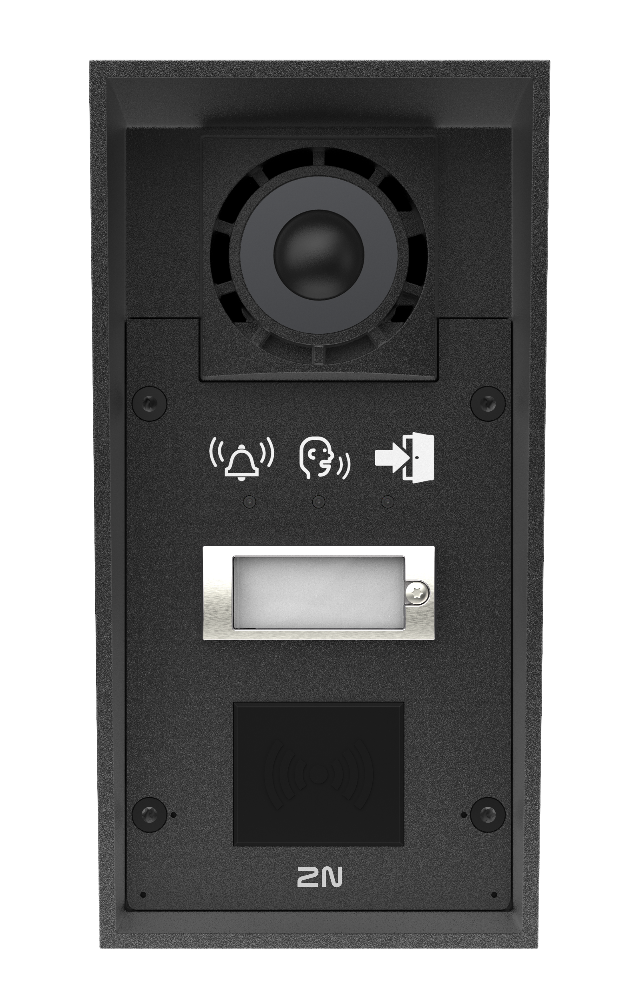
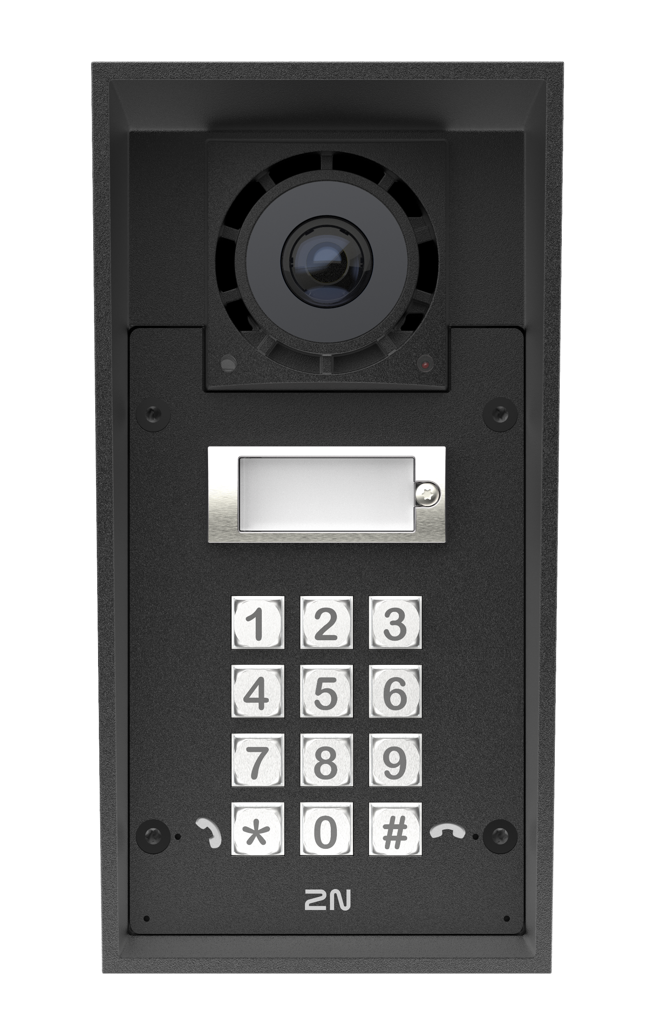
2N IP Force 2.0
The world’s most durable IP intercom with a 5MPX camera

Slide 23
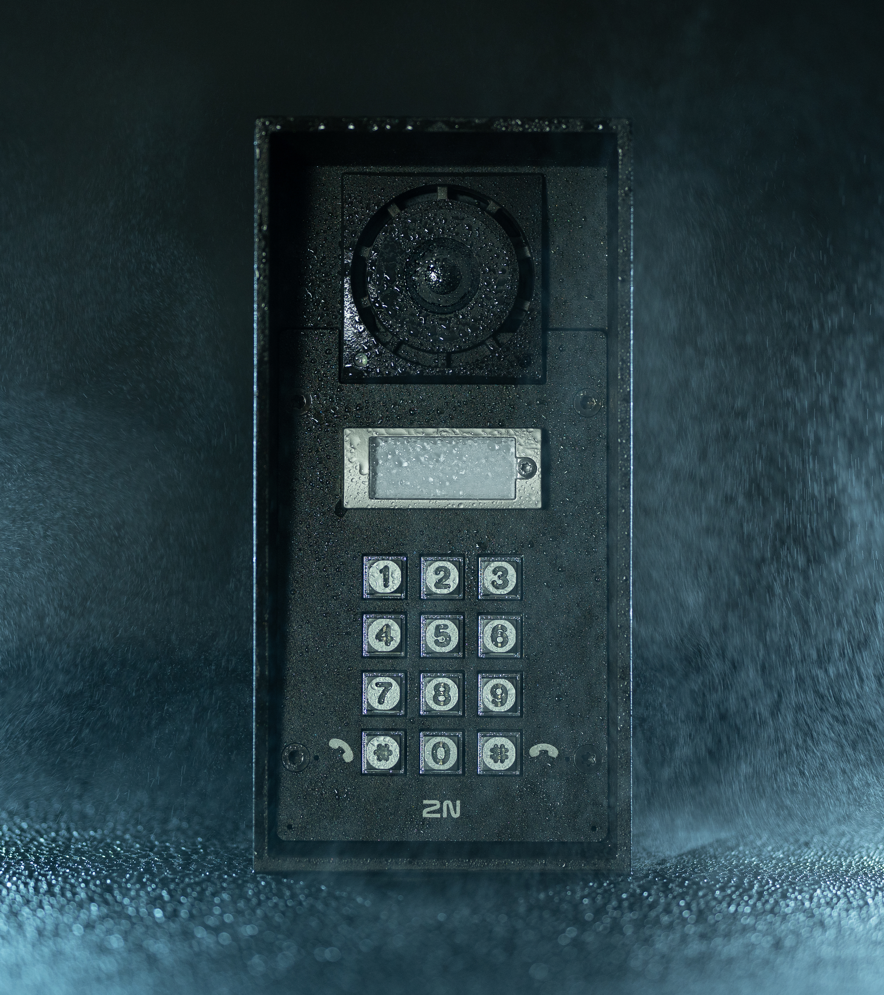

2N IP Force 2.0 features
Our most durable unit
An extremely durable intercom made from aluminium, it will withstand extreme conditions, including dust, water, and significant impact.
It also has a dome over the camera for greater shatter resistance.
Notes:
Material – the same, the chassis is slightly different. On the front panel, we removed the plastic side panels – nothing to break to get inside, harder to get into, no weak point!
The frame – might be easily removed. Only for flush installations, to avoid this issue, it can be installed surface or on a gooseneck.
Dome – the same dome that Axis uses on their mini-cameras, highly resistant

Slide 24

5MPx camera
Ensures clear colour images even in low light, switching to night vision only in complete darkness.
It also supports WDR to prevent glare, and the wide-angle lens is enhanced with adaptive face zooming for excellent visitor verification.
Notes:
Key improvement from the last generation – the camera. As is standard with ARTPEC devices, this camera is very high quality – more than HD images – QHD. It offers all the features you’d expect for reliable visitor verifiction – night vision, WDR, and adaptive face zooming.

Slide 25
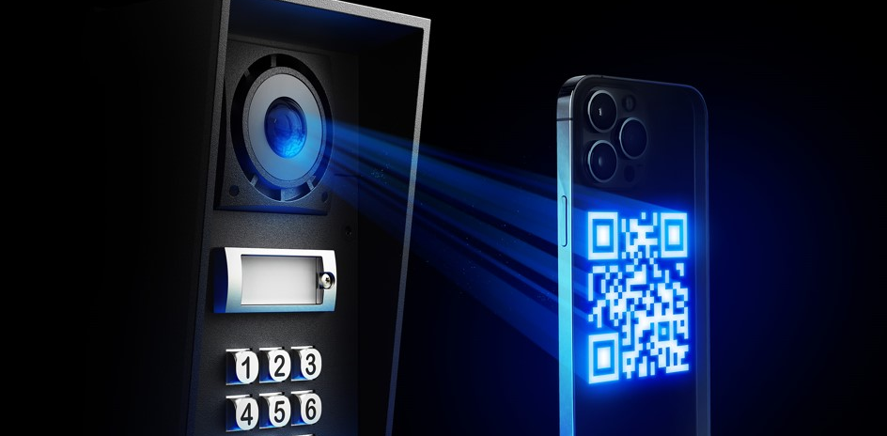

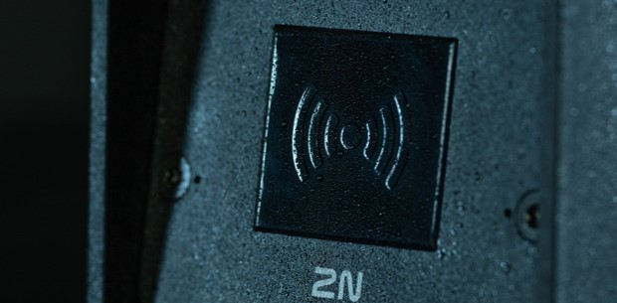

2N IP Force 2.0 features
QR code access
The Axis ARTPEC-8 powers multiple advanced features, including QR code reading.
Use it to assign guests QR code access in advance to ensure seamless guest entry.
Clear, reliable sound
Noise cancellation, a high-volume speaker, adaptive volume, and automatic audio-loop tests all ensure effective communication you can count on in loud, busy environments.
Robust access control
Choose from RFID, keypad, or button units.
OSDP support also enables encrypted RFID access and communication with third-party access control systems

Slide 26

2N IP Safety
Designed for emergency communications
Reliable communication
IK10 & IP69K certified
Always visible and functional
Integrates into existing systems
Choose from three versions: one button, two buttons, or a raised emergency button.

Slide 27
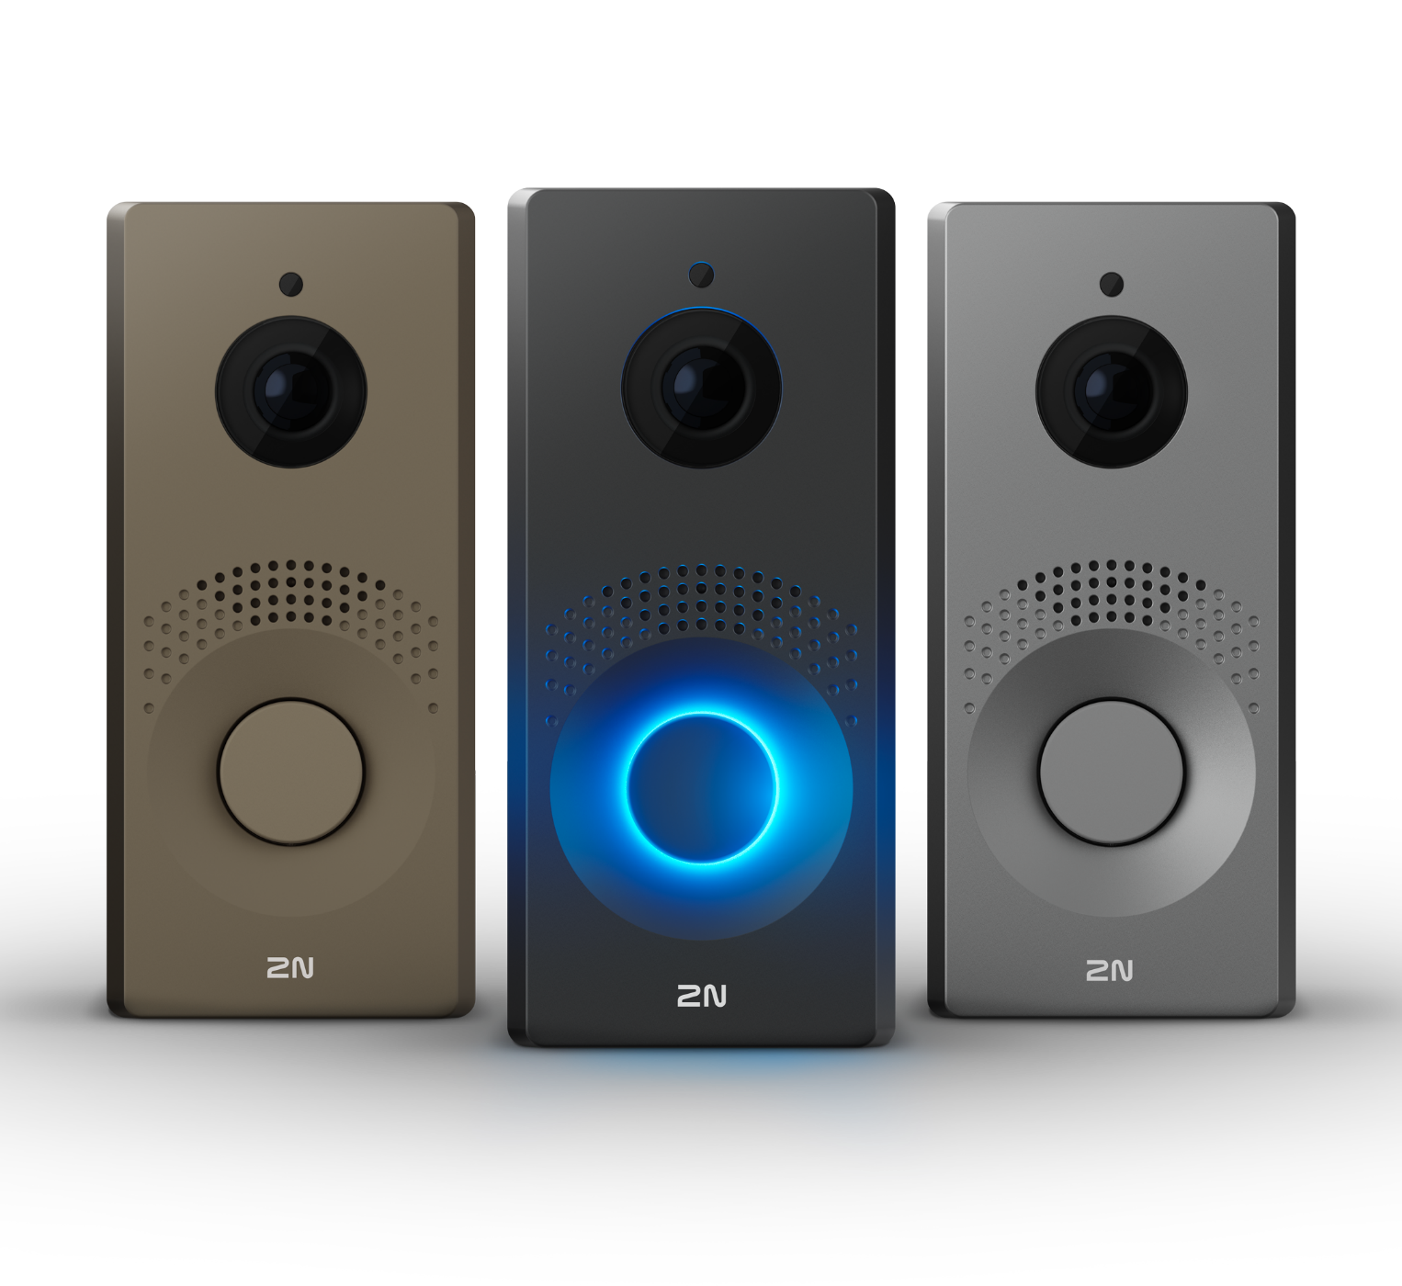
2N IP One
One Family. One Home. One Smart Intercom.

Slide 28
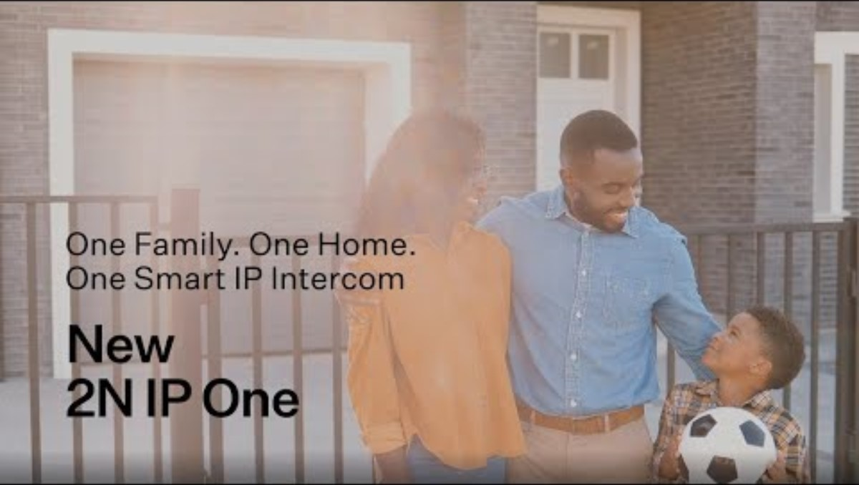

Slide 29

2N IP One features
Great durability
This is no ordinary plastic video doorbell.
With IP66 & IK08 certifications, the 2N IP One is truly durable.
The body is made of high-quality anodized aluminum, which ensures exceptional resistance to vandals, water, and dust.

Slide 30
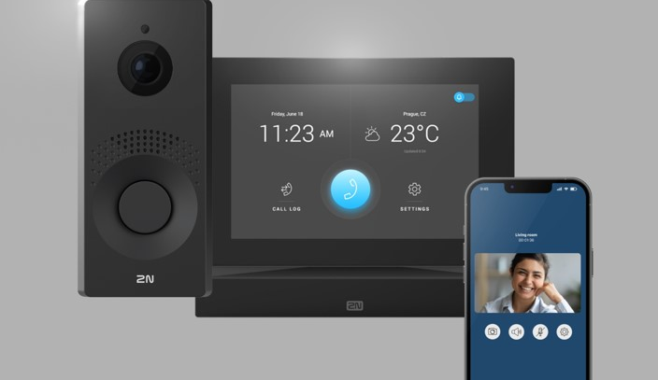
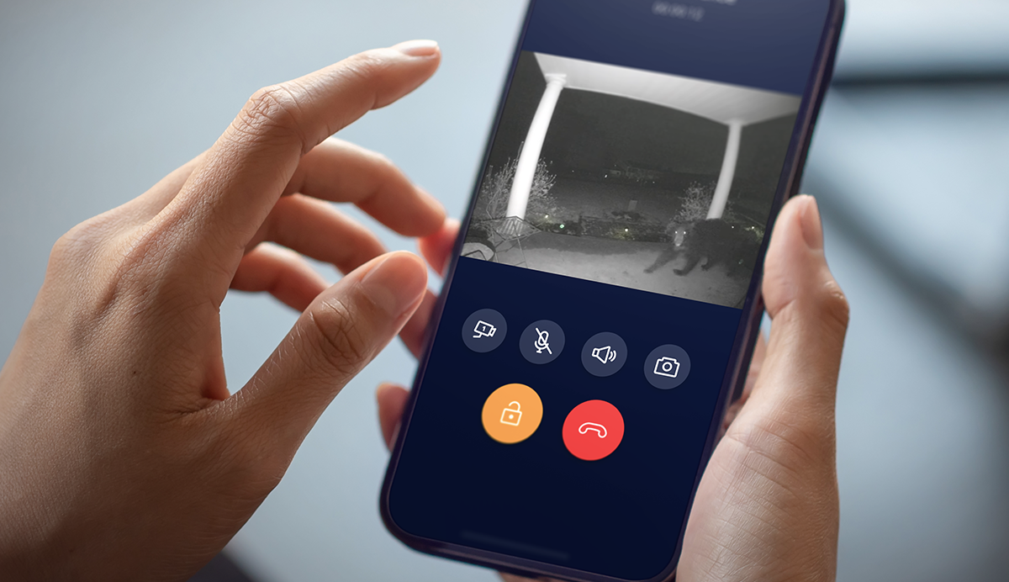
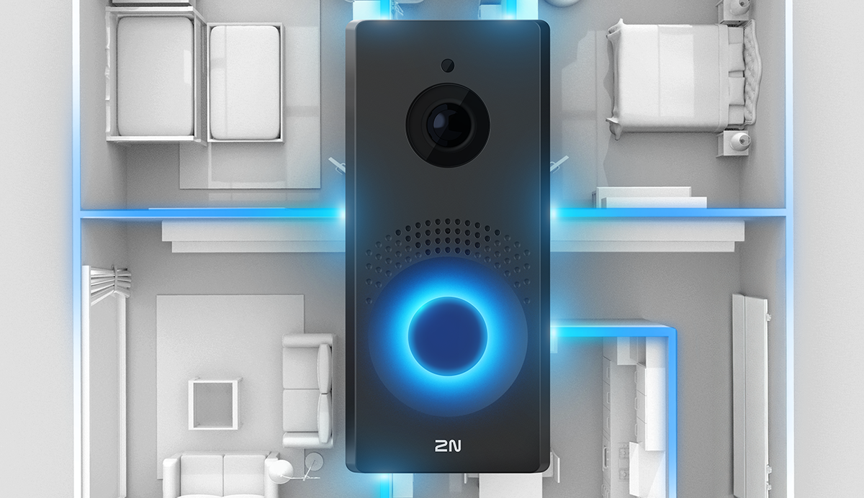


2N IP One features
Door control
Connect the door strike to the 2N IP One so that residents can answer the door via the My2N app/indoor station, let visitors in with QR codes, or unlock the door using the app.
Full HD surveillance
Enhance home security with motion detection. Residents will be notified, and the Full HD camera will record the surroundings immediately
Easy integration
Based on open protocols and supporting multiple plug-ins, you can integrate the intercom easily with leading third-party technology
.

Slide 31

2N IP Solo
A great addition to smart home entrances
Hidden HD camera
Compact design
Integrates with home automation
Available in nickel and black

Slide 32

2N IP Base
Designed especially for smaller-scale installations
Compact IP intercom with HD camera
High-quality video & audio
Very easy to install

Slide 33
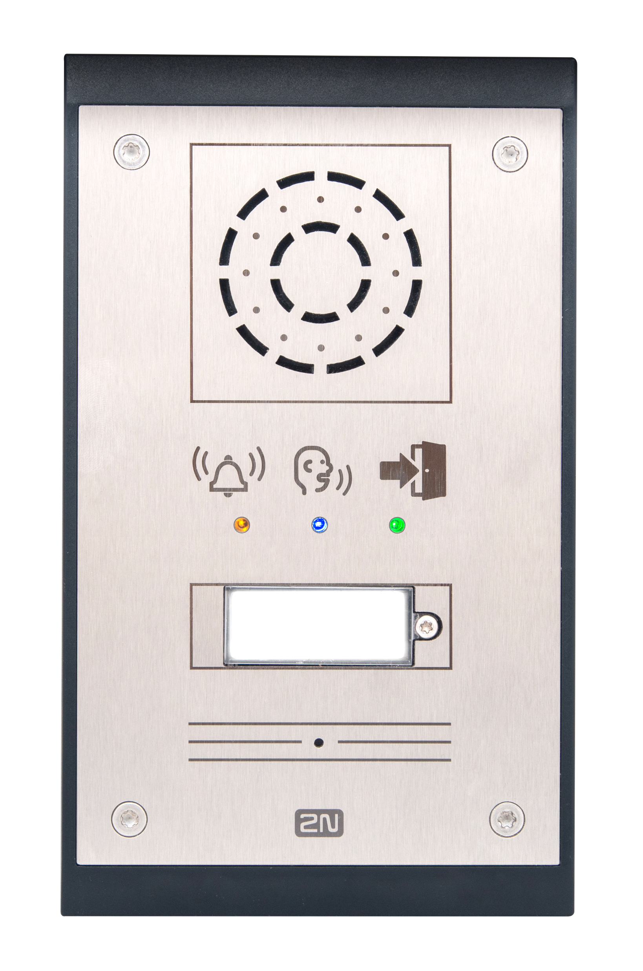
2N IP Uni
For general-purpose outdoor and indoor environments
Dependable communication with emergency services or helpdesks
Easy installation
Visual status signalling
Effectively replaces analogue intercoms

Slide 34
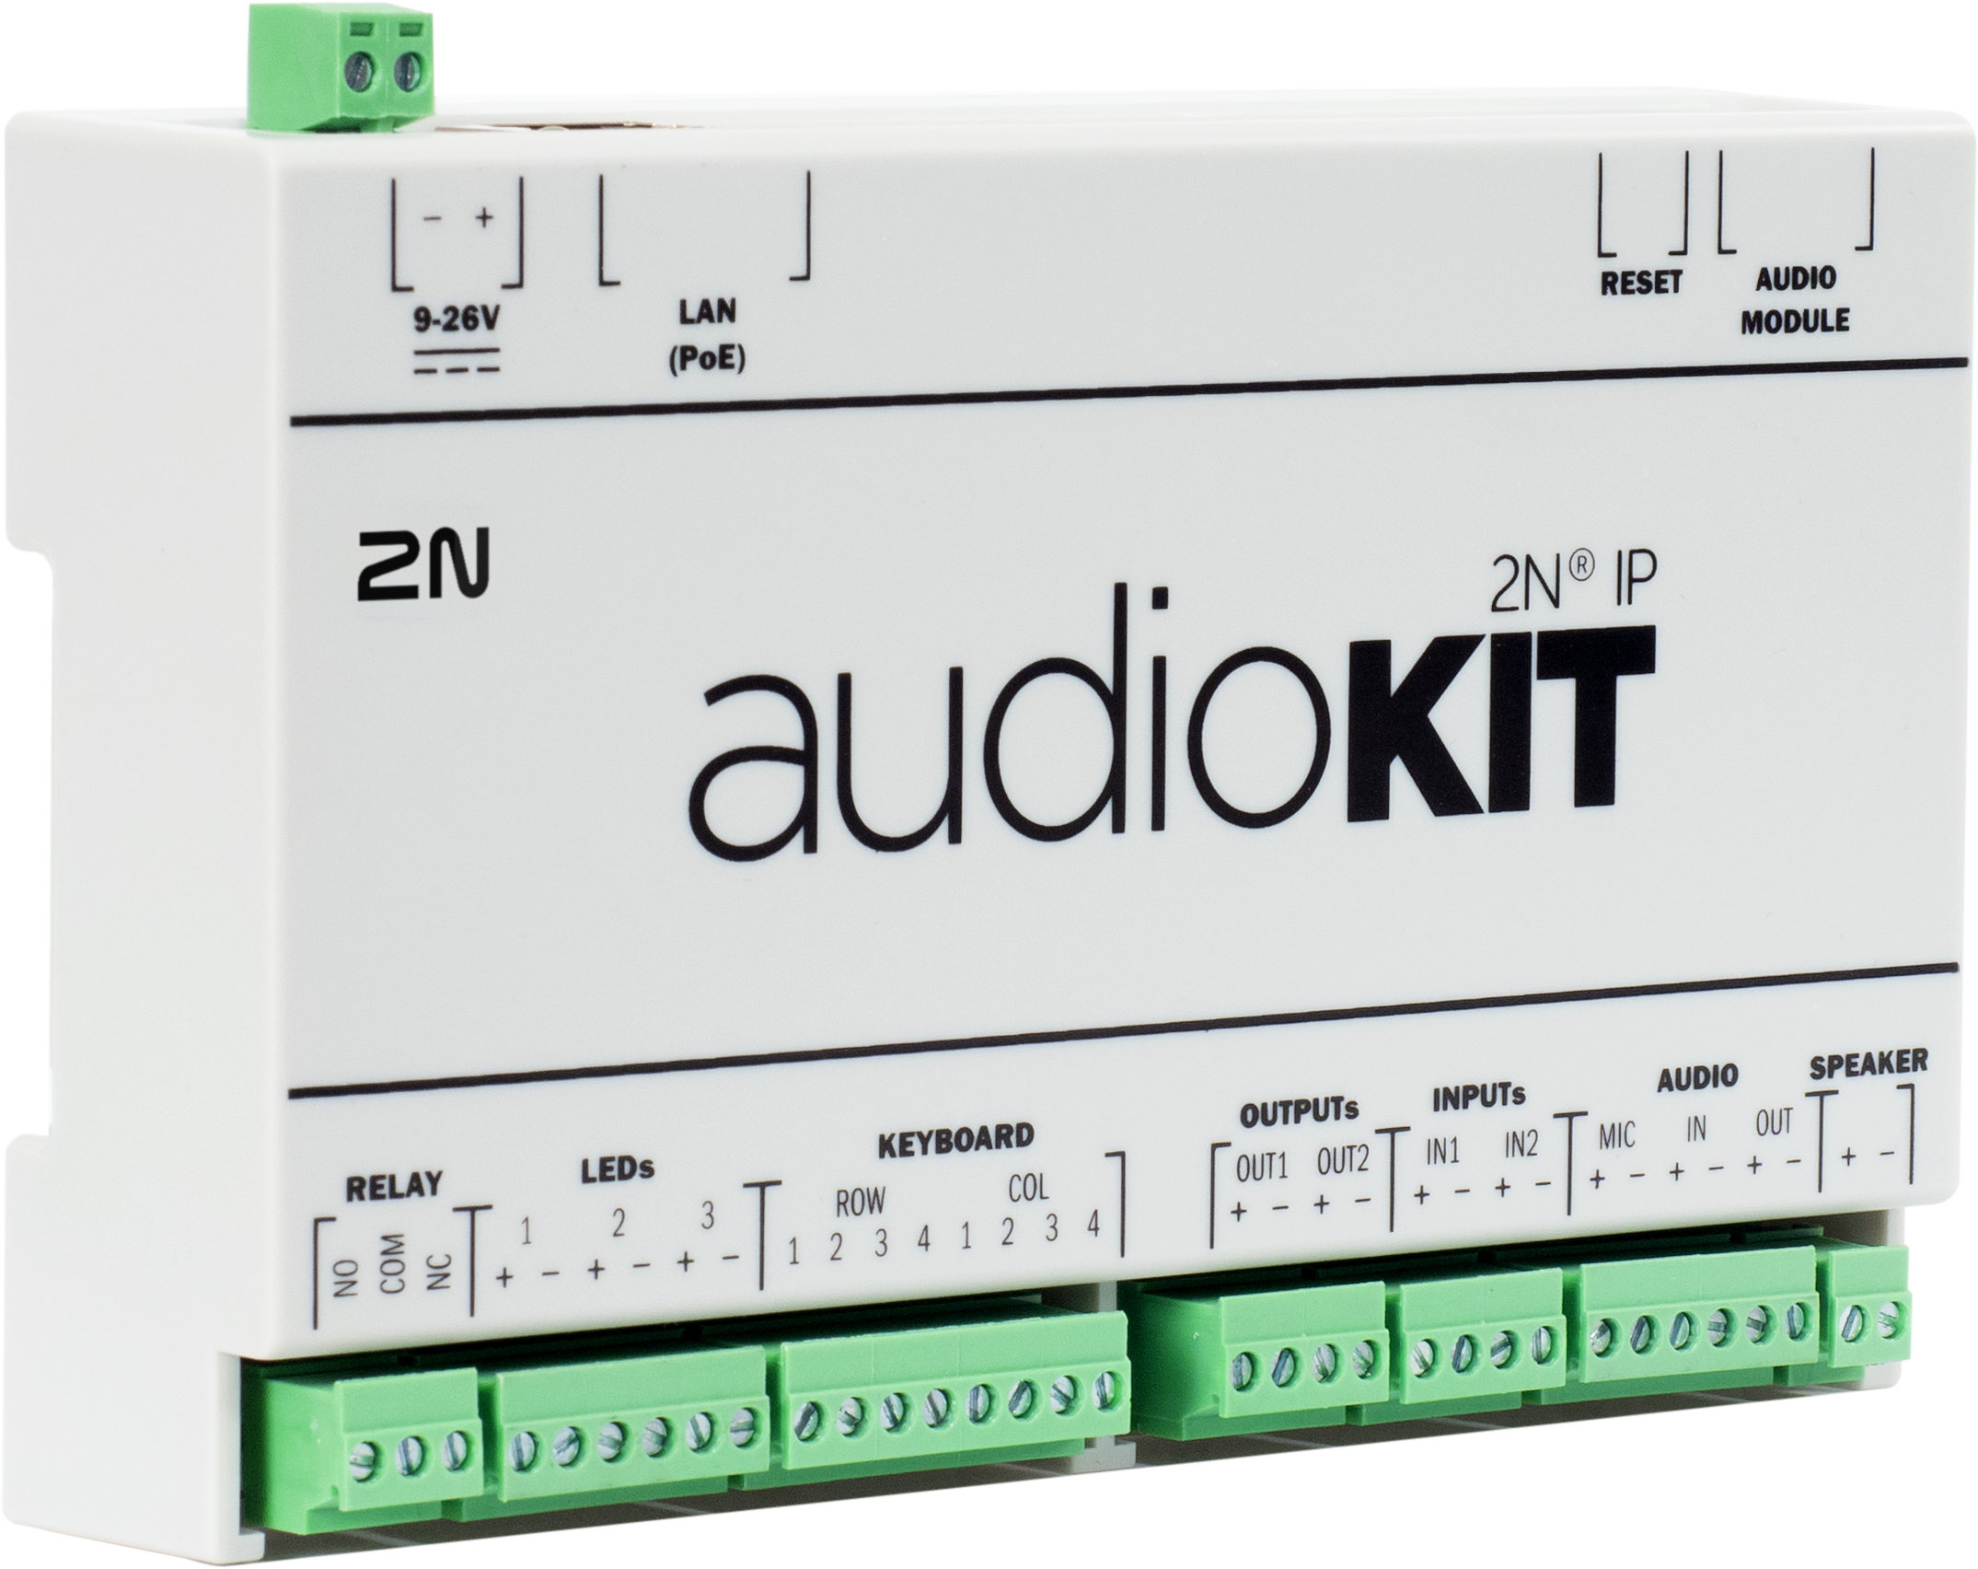
2N IP Audio Kit
OEM intercom intended for incorporation into a variety of devices
Adds value to both audio communication and remote surveillance and control
A VoIP solution you don’t have to develop
Remote configuration
A wide range of connectors

Slide 35








Key takeaways: Why choose 2N IP intercoms
EU
Core part of a 2N access solution
Versatility: an intercom for any vertical
Built to last in the EU
Innovation
Strong cybersecurity
Easy integration
Seamless access
Easy remote setup and management
Notes:
RED-compliant

Slide 36
Offer your customers the best in modern intercoms

