Slide 1
2N® IP Style
Setting a new standard for video intercoms

Slide 2
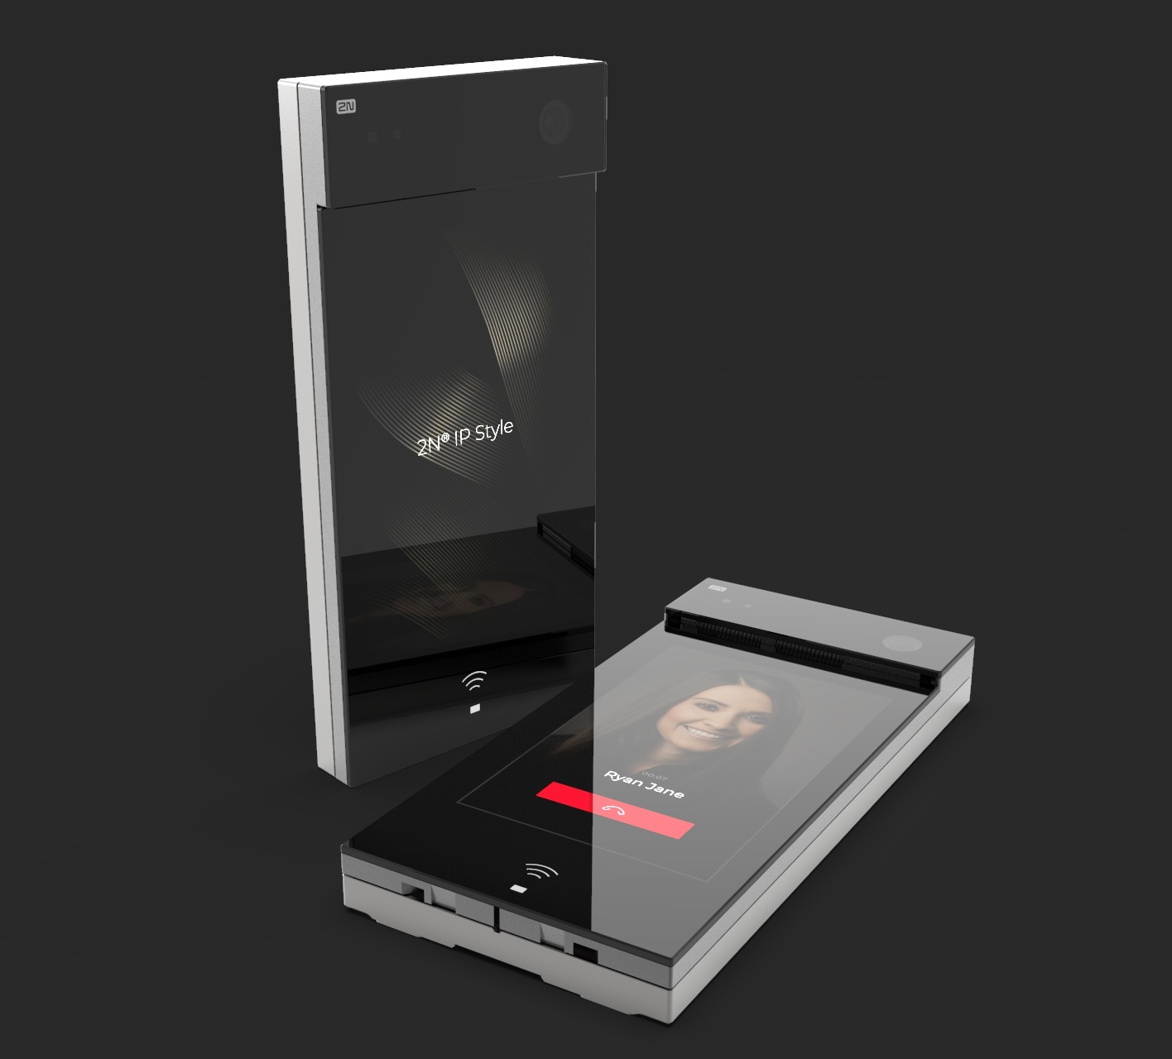
Agenda
Why we have developed 2N® IP Style
Innovations and the new platform
Mounting and accessories
Options for configuration
Product comparisons

Slide 3
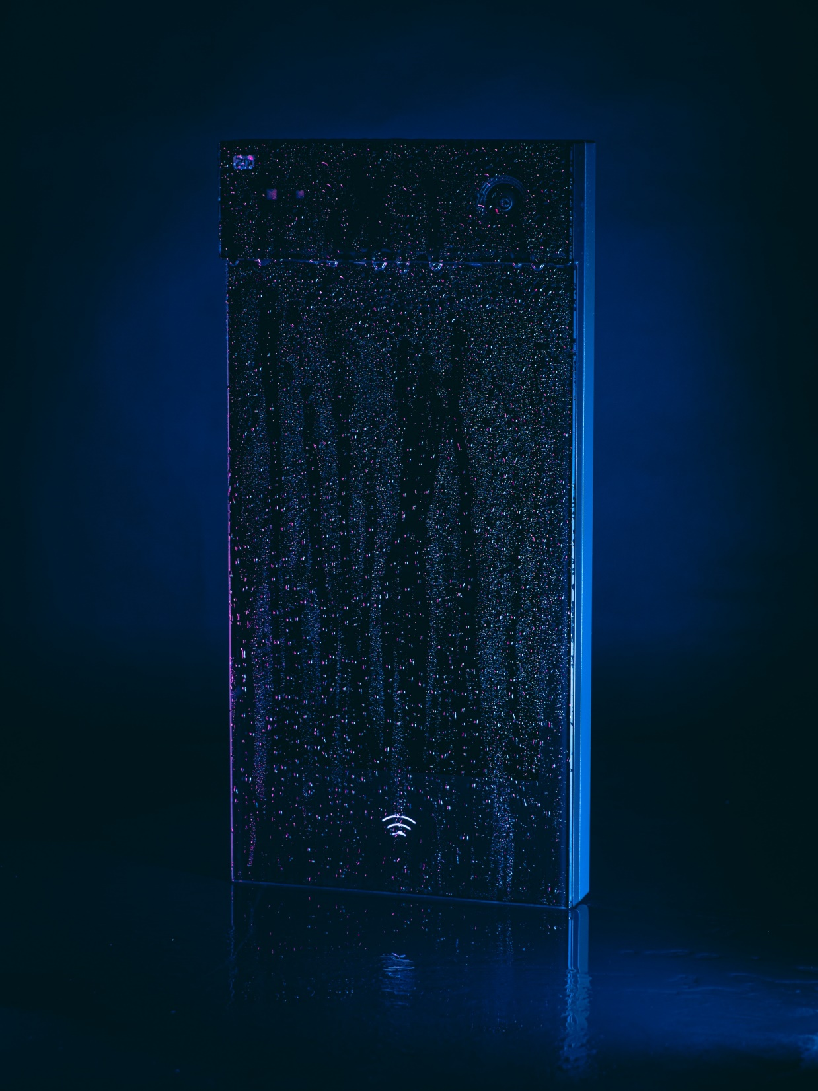
Why did we develop it?
Notes:
We had basically two strong reasons why. In the past 10 years we saw huge and wide adoption of touchscreens.
Even though the technology is with us for some time, it really started with the first iPhone in 2007 and this milestone set the trend for the following decade.
Today everyone has a mobile phone with touchscreen, you use it to turn on A/C or set GPS in your car, control your smartwatch, pay for parking or even to order food in a fastfood.
Touchscreen is considered as a standard wherever it can replace standard screen controled by buttons. For an intercom it also makes perfect sense as you can squeze thousands of contacts into a relatively compact device together with other interfaces for access control etc.

Slide 4
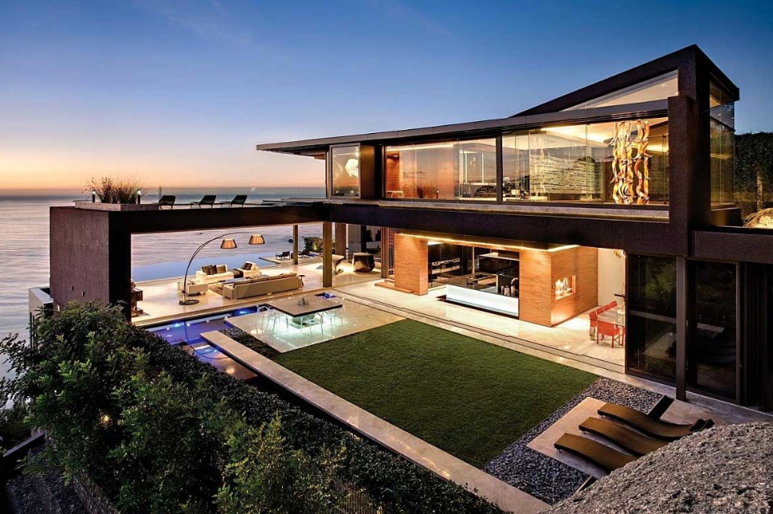
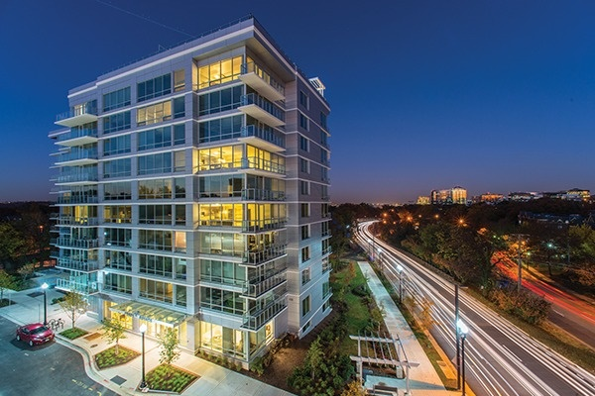
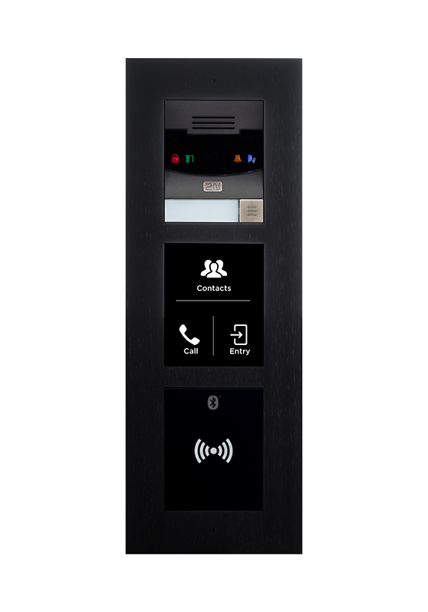
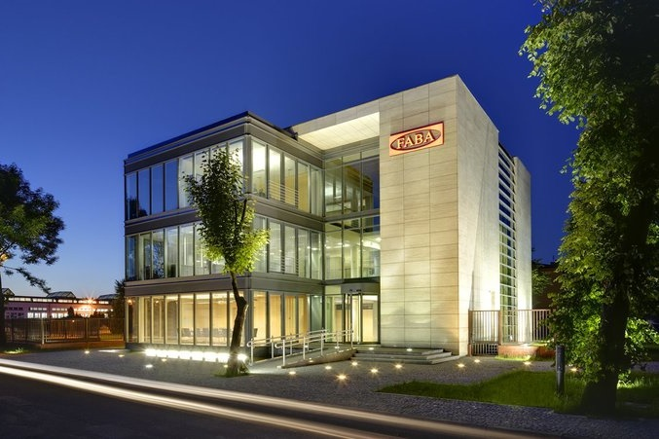
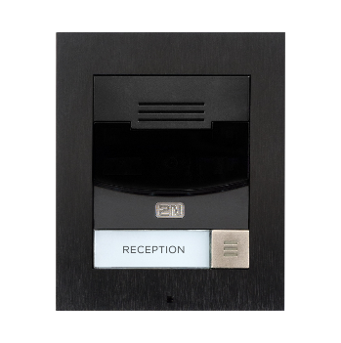
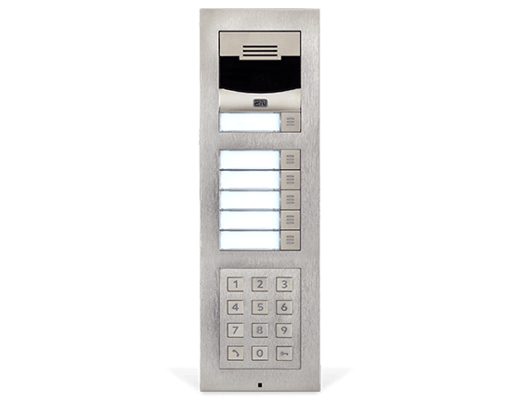
Product positioning
Single villa
Large MDU or office building
Smaller MDU or office building
JOHNSON
Notes:
Today Verso - our flag ship represents the best what 2N can offer and its our bestseller at the same time. Thanks to the modularity it is a great fit to smaller even to large MDU and office buildings.

Slide 5
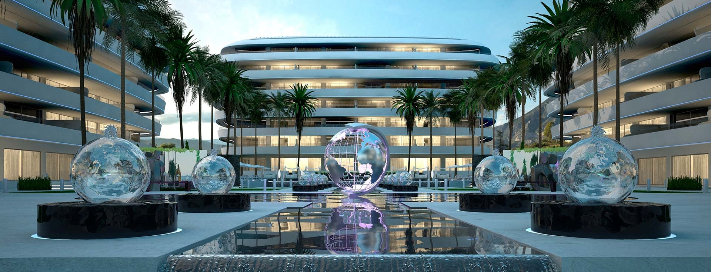
“For high-end office and residential buildings customers request an even better and more luxurious intercom.
One with large touch display!“
Notes:
Feedback from the market – we knew that we have to develop IP intercom with big touch screen but what exactly should this intercom include?
IP Style will replace Verso on the throne of the top notch product and will optimize our portfolio. At the same time it will show technological capabilities of 2N to the market.

Slide 6
What exactly do customers want?
Notes:
We made a market research to really know what our customers really want and what they are willing to pay for. Based on their feedback from the market we found out that their primary demand is for the fully touch-based intercom with full HD camera, multi-technology access control and outdoor mechanics. On the other hand, almost nobody was interested about biometricThis intercom tailored to modern office buildings and higher-end residential complexes. Keeping this in mind and following the latest market trends we´ve decided to come up with the new, premium IP intercom - with 2N® IP Style.

Slide 7

2N® IP Style
New flagship intercom with full HD camera, next generation mobile access technology, and large display in a sleek design.
Notes:
Our long-term sales experience with 2N® IP Verso gave us strong base for development of new intercom perfectly aimed to our customers' needs.
Combined with possibilities of our new platform we wanted to introduce truly flagship product.

Slide 8
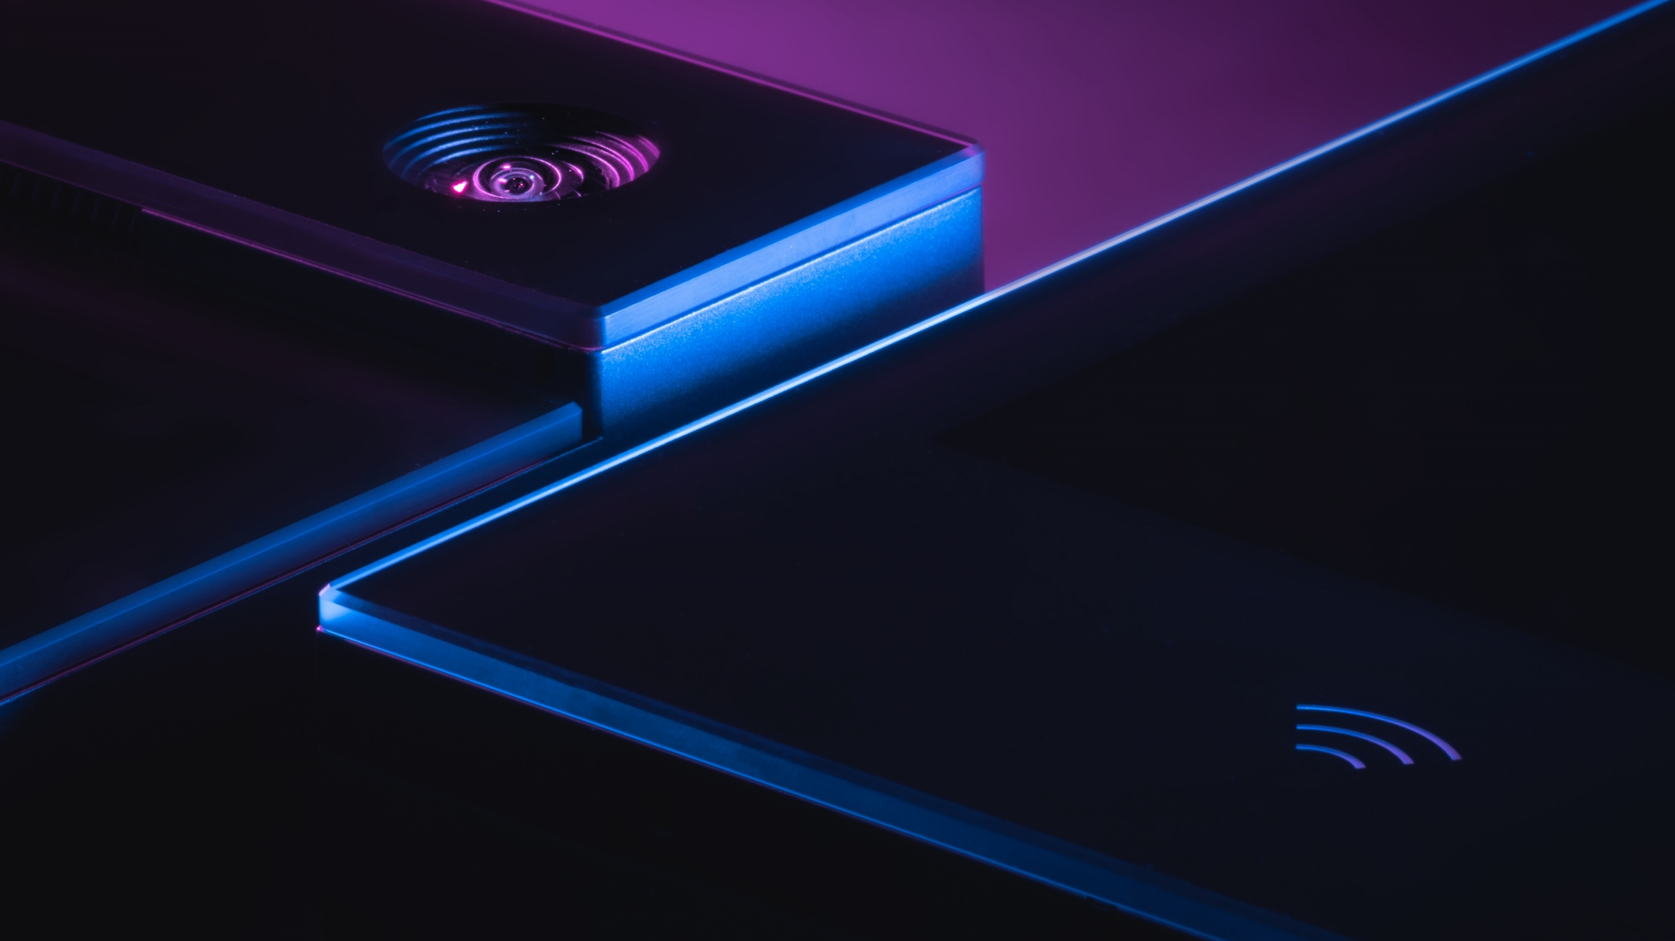
What makes it unique?
Notes:
What exactly makes this brand new IP intercom unique on the market…

Slide 9

AXIS ARTPEC-7 chip at the heart of the image
Thanks to the Axis platform, 2N® IP Style defines new standards for video intercoms.
Notes:
Hearth of device is Artpec 7 chipset from Axis. The new HW platform gives us enough computing power for high resolution video proccessing, WDR, new motion detection or QR codes in the future.

Slide 10
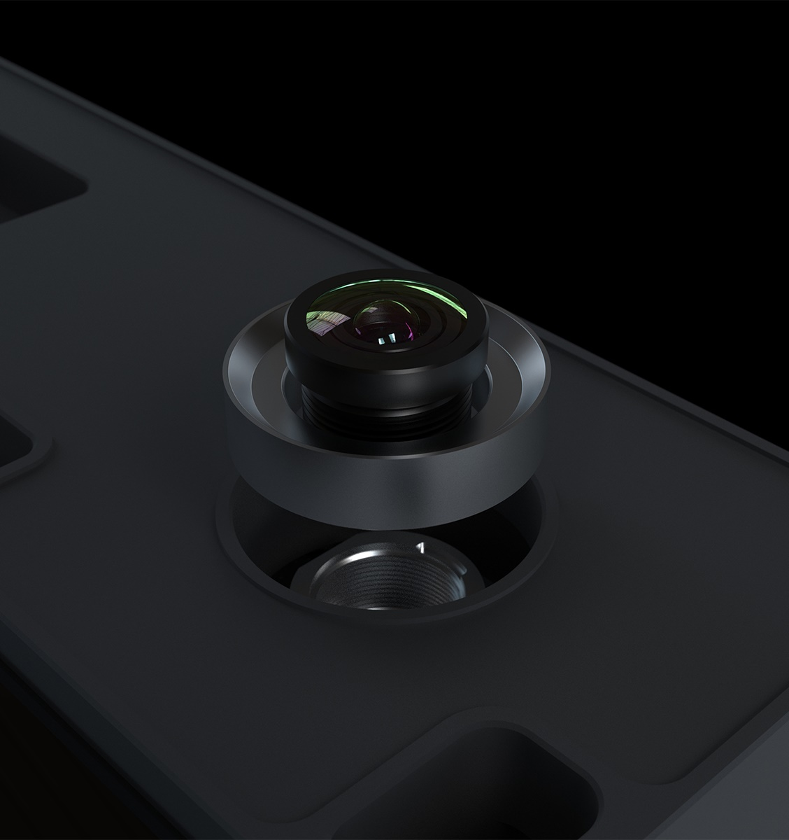
Camera of the future
5 MP
  High resolution video processing
    QHD (1440p) used in the RTSP stream
    FullHD (1080p) used in SIP call
    Multiple simultaneous full HD streams
  Wide dynamic range (Forensic WDR)
    Perfect picture even in changing light conditions
Notes:
The highest resolution of the camera is QHD (1440p) this resolution can be used in the RTSP stream.
FullHD (1080p) used in SIP call – wide screen video in perfect quality in 2N® Indoor View
can handle multiple simultaneous full HD streams and has a 5 MP chip. It supports WDR and provides colour image, even in low light conditions.
Wide dynamic range (Forensic WDR)
Unlike cameras, intercom can't be positioned to avoid issues with direct sunlight
camera can compete with most outdoor IP cameras from leading manufacturers

Slide 11
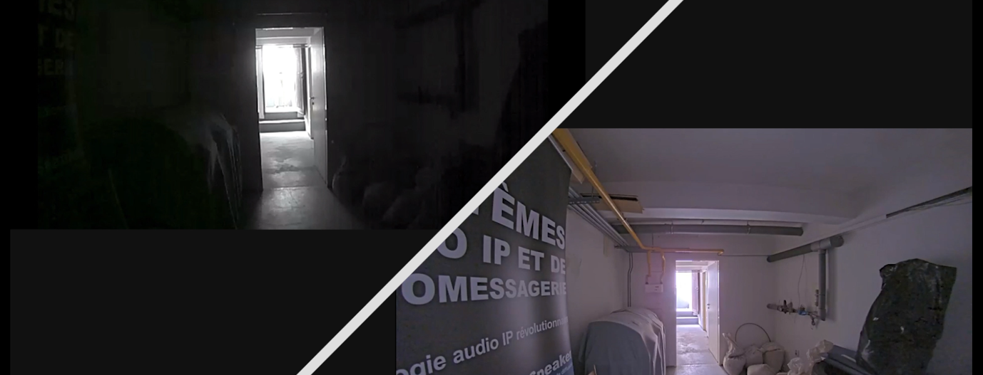
  2N® IP Style (with WDR)
  2N® IP Verso (w/o WDR)
  (Typical of IP intercoms in the field)
We make dark areas bright again
High sensitivity image sensor and ARTPEC-7 chip allows to keep color image where typical intercoms would have to switch to IR mode, or not see anything at all
Notes:
Top performance in low light conditions
Difference between 2N® IP Verso (w/o WDR) and 2N® IP Style (with WDR) in the dark area facing the direct sunlight
Camera of 2N IP Style with all the postprocessing controled by ARTPEC -7 chipset can compete with most outdoor IP cameras from leading manufacturers

Slide 12
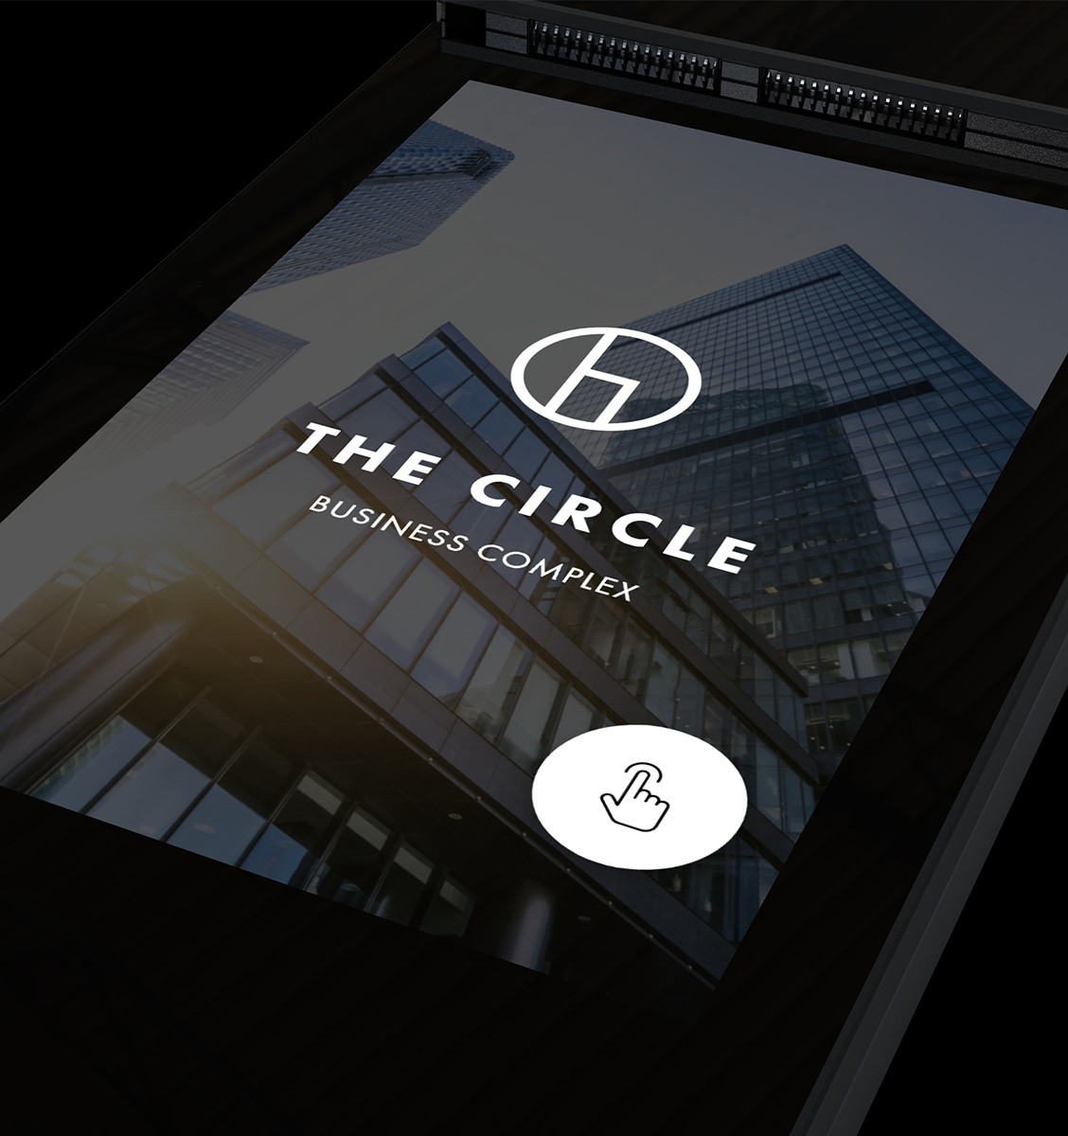
Premium 10” display
  Big screen with 1280x800 resolution for sharp text and graphics
  The extreme brightness guarantees excellent readability even in sunlight
  Immediate response to any touch – the same user experience as you expect from top smartphones
  Smooth animations as expected of a premium product
Notes:
First of all – BIG screen menas comfort, but we went beyond to just have a big srcreen.
We spend several months to develop our own display framework to make all animations and interactions lightning fast, so you have real feeling of luxury
The extreme brightness of the display guarantees excellent readability, even in direct sunlight.
You will also captivate users with the immediate response and smooth animations.
With resolution 1280x800 the picture and animations are nice and sharp.

Slide 13
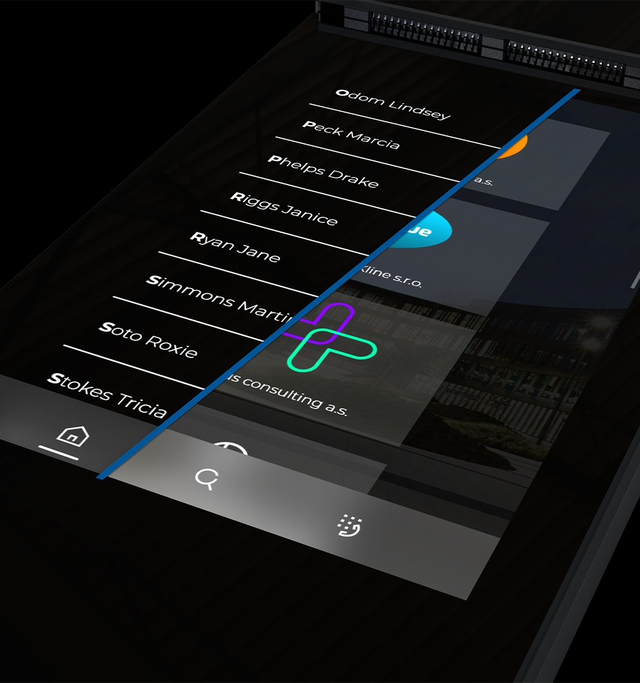
Customizable UI
  Two different ways of displaying the intercom’s user interface
    MDU buildings – list of all residents in alphabetic order (in flat structure)
    Office – list of companies’ logos (users are in the directory structure)
  Idle mode supports: slideshow, pictures, static logo or address of the building
Notes:
Also we knew that Office installation has different needs from residential
Select from 2 different ways of displaying the intercom’s user interface. For apartment building the integrator can setup only „direktory“ mode – list of contacts. For office complexes with many companies inside it is better to use „card“ mode – each company has its own logo and folder with the employees..
Also idle mode offers more possibilities how to set it up – let the Customer choose if they want to display some logo, building address or slideshow of more pictures.
Simply, tweak the user experience to perfection.

Slide 14
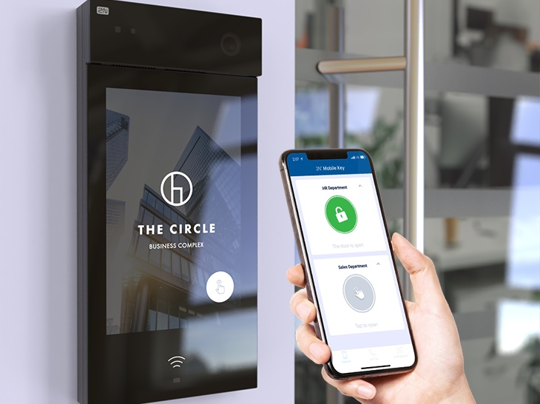
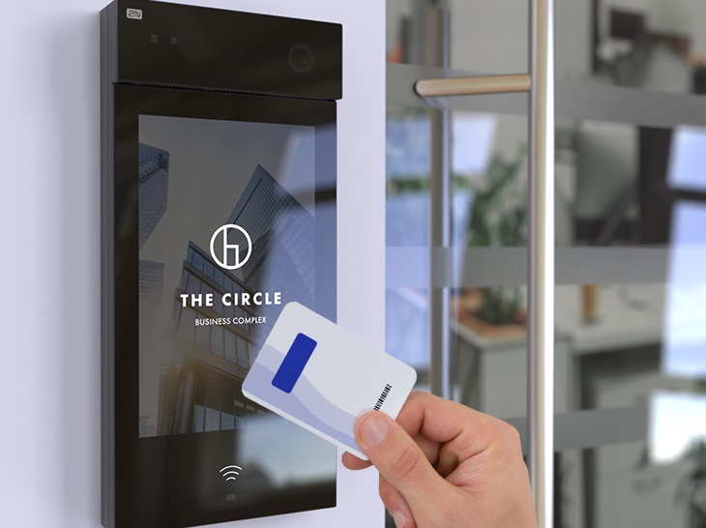
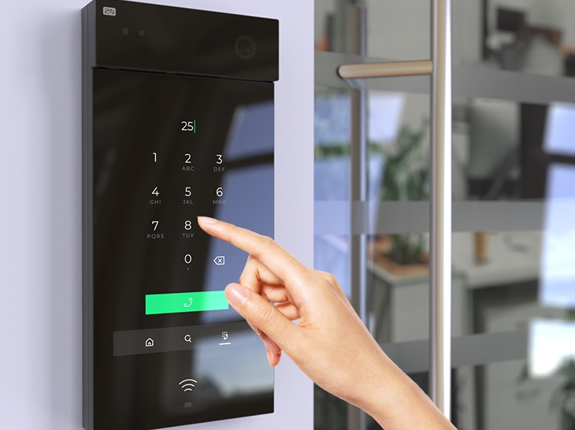
3 in 1 access control
WaveKey mobile access
Multifrequency RFID
Smart Pin Keypad
Fastest mobile access control technology with proven reliability
Frictionless distribution of credentials
Modes: Touch, Tap in app, Motion, Card
All possible card technologies in one package – you don’t have to think about what card you have
Supports secured HID cards (SE, Prox)
Multi factor authentication, backup or simple method of authentication
Security feature: scrambled keypad
Notes:
Another great advantage against the competitors is our 3in1 access control system. Besides multi-frequency RFID reader and PIN keypad, the IP Style supports our patented WaveKey technology for mobile access. It brings the reliability and convenience to the end users and also to building managers. They can remotely issue and revoke crednetials, completely for free, completely frictionless. Plus they do not need to spend any cent for lost or damaged RFID cards.

Slide 15
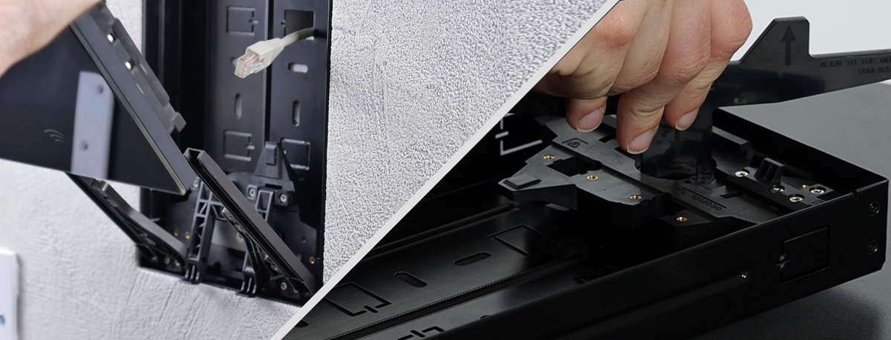
  2N® IP Style (with WDR)
  2N® IP Verso (w/o WDR)
  (Typical of IP intercoms in the field)
Pleasure to install
  Our patented mounting mechanisms minimized the possibility of incorrect installation:
    Tilt-out system – to slide the intercom into the installation box
    Elevation system – change the depth of the recessed box if the box was too deep
Notes:
Top performance in low light conditions
Difference between 2N® IP Verso (w/o WDR) and 2N® IP Style (with WDR) in the dark area facing the direct sunlight
Camera of 2N IP Style with all the postprocessing controled by ARTPEC -7 chipset can compete with most outdoor IP cameras from leading manufacturers

Slide 16

Certified durability
  IK08 certified glass will easily deal with daily intensive use with no signs of scratches or worn
    4mm chemically hardened glass withstands hits and vandal attacks
  IP65 ingress protection ensures resistance against heavy rain and dusty environment
    Display resistant against water, heat, and direct sunlight will serve your guests in any country
Notes:
Don’t be fooled by the fully glazed surface. The 2N® IP Style can easily resist heavy rain, a dusty environment, and even attacks by vandals.
IP65 ingress protection and display resistant against water, heat and direct sunlight will serve your guests in any country or weather conditions
Intensive office use, keys in hand and houndreds of visitors per day, or residential use with kids that are trying to challenge how tough that glass will be .

Slide 17
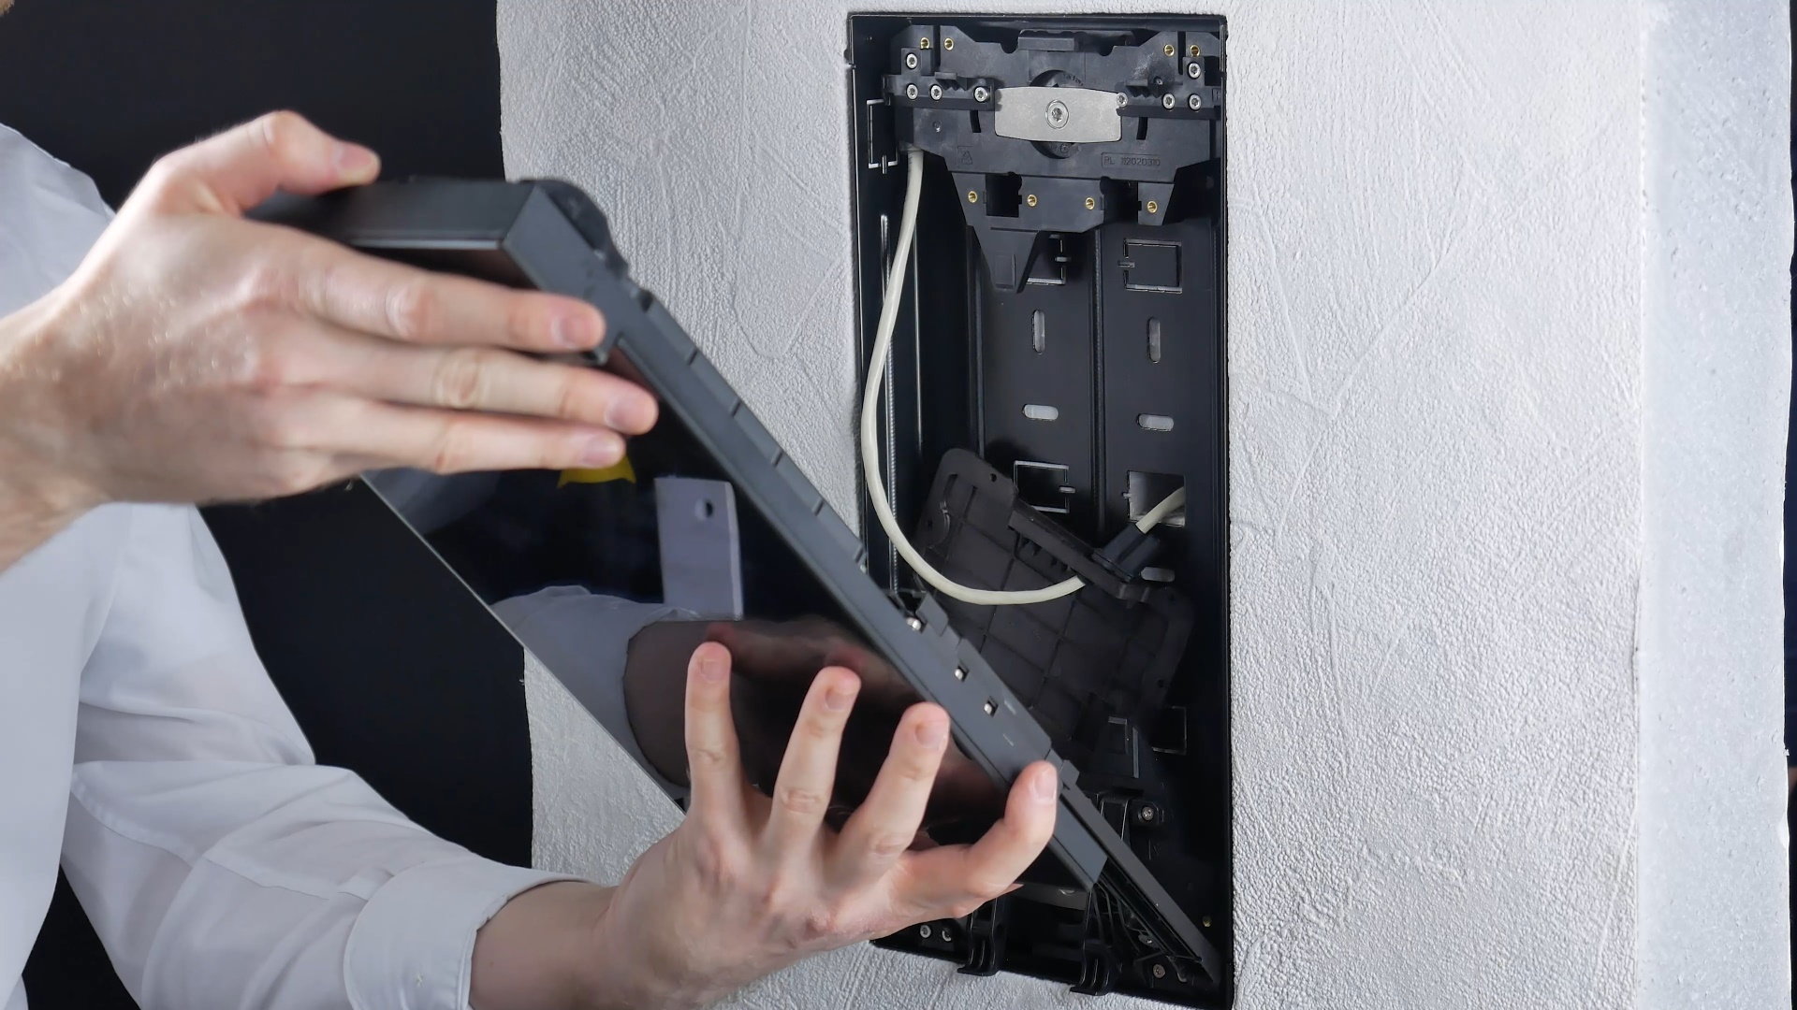
Mounting and accessories

Slide 18
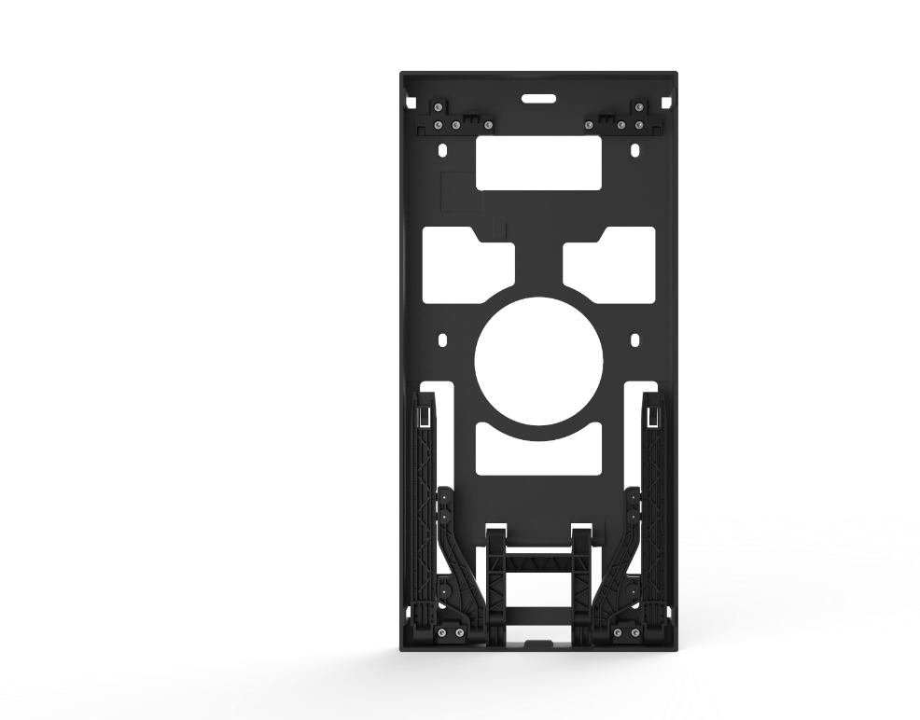
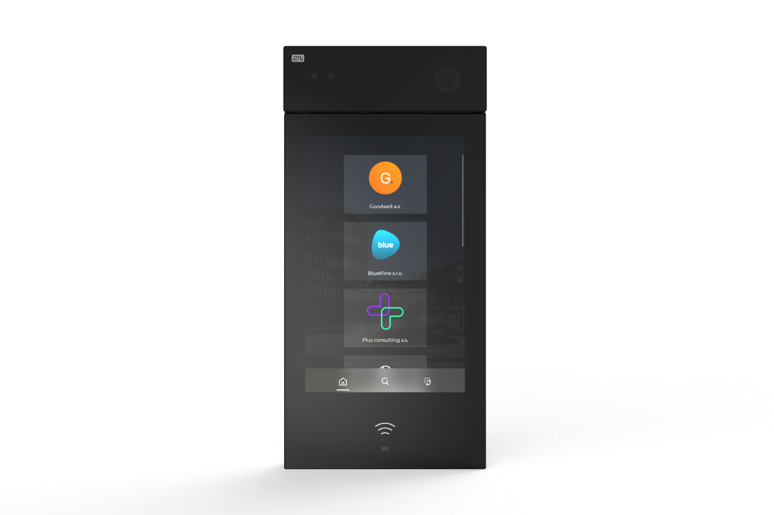
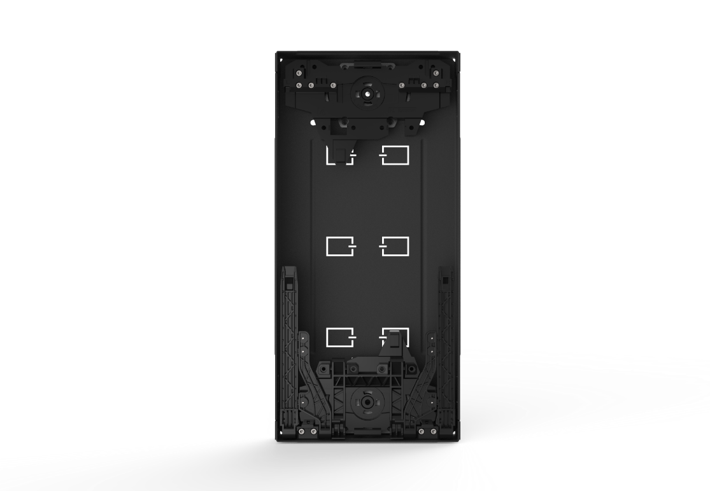
Main unit
Surface mount box
Mounting box to install the 2N® IP Style intercom on the surface of a wall
Always choose a box (mandatory)
Flush mount box
Accessory for recessed installation with
a special elevating function. It helps you align the intercom with a wall’s surface.
Both boxes has a unique tilt-out mechanism which gives you plenty of room to work with cabling.
Notes:
The installation is quite easy, the main units itself has monolitic desing so no modules are needed. So in fact the installer will need just 2 ordering numbers. The main unit with a flush box or surface installation chassi.

Slide 19
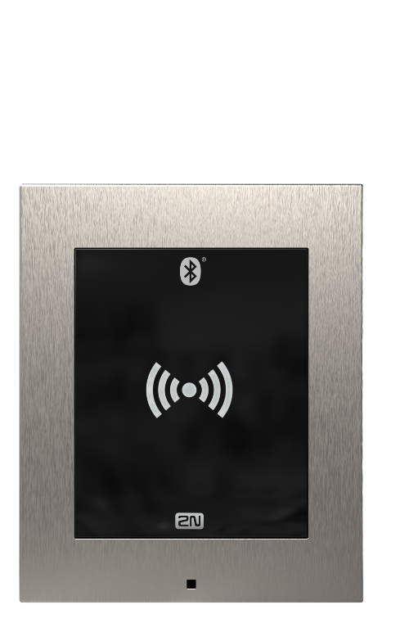
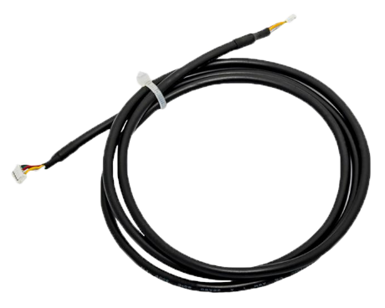
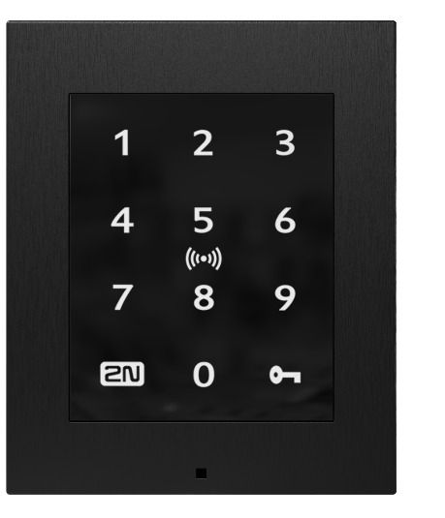
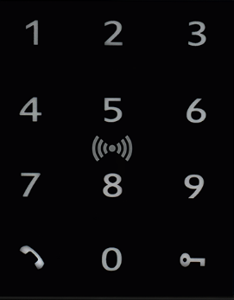
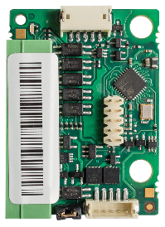
Special accessories
2N® IP Style is equipped with Vbus connector
The same one used by 2N® IP Verso or 2N Access Unit 2.0
for the connection of additional modules
Why to use Vbus connector on 2N® IP Style?
Connection of Wiegand module to integrate the intercom
with 3rd party access control systems
Connection of any reader from 2N® IP Verso on the indoor side of the entrance (OUT reader)
Notes:
As the unit has vbus connector, Verso wiegand module can be used together with Style for integration with 3rd party access control systems. Of course, the same will apply on the upcoming OSDP moudule. Also, you can for instance use Verso RFID reader on the indoor side of the entrance as a OUT reader.

Slide 20
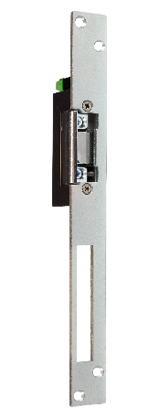
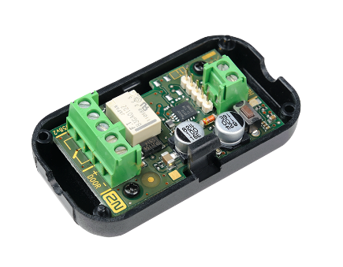
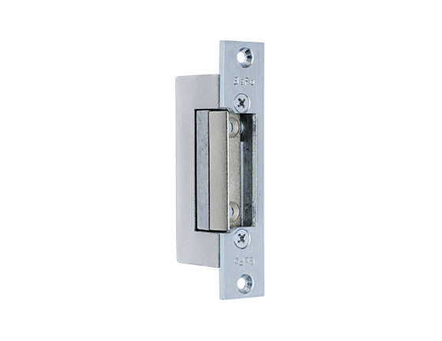
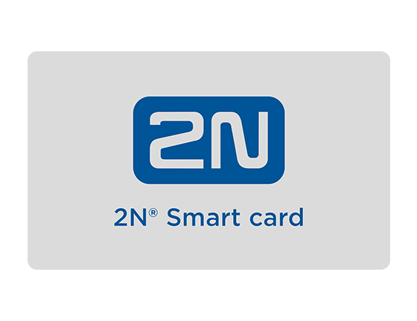
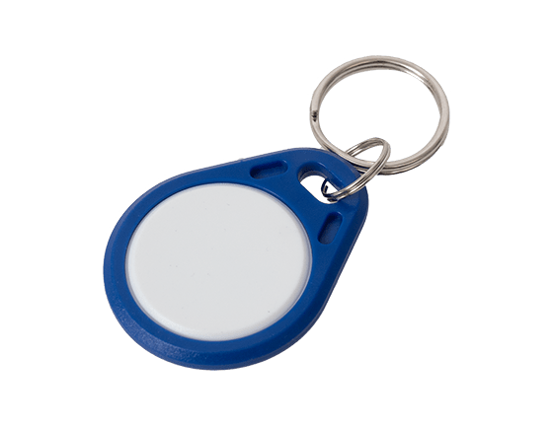
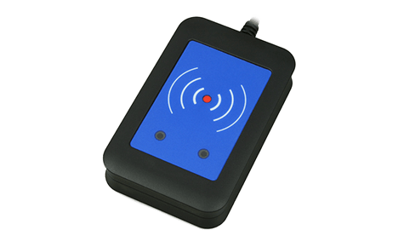
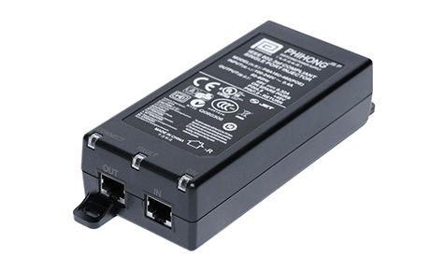
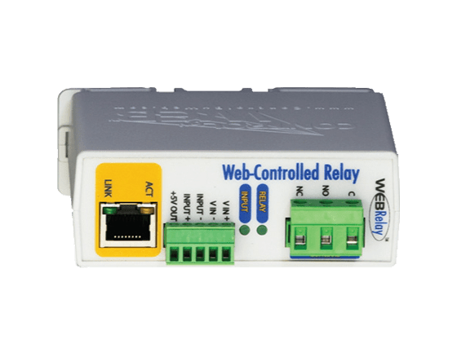
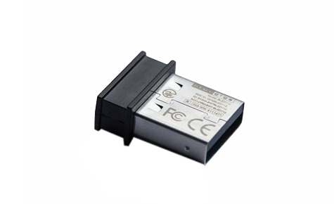
Additional accessories (common)
Communication & Access Control
HD audio and video quality
Open standards for integration
2N® Security Relay
Door strikes
RFID cards and fobs
External USB readers
PoE+ injector
External IP relay

Slide 21
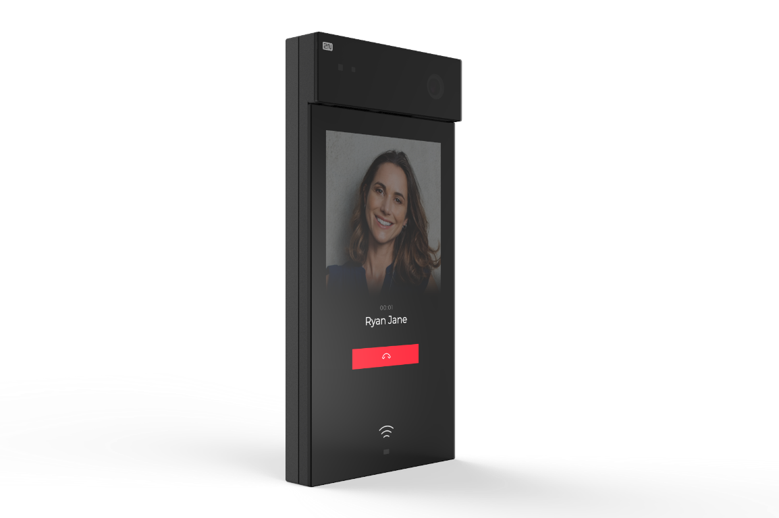
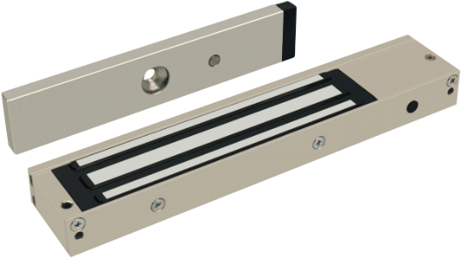

Recommended installation
Communication & Access Control
HD audio and video quality
Open standards for integration
Door strikes
“DOOR”
“OUT1”
2N® Security Relay
“Relay”
12V
Magnetic lock, electromechanical lock
2N® IP Style
For security reasons we strictly recommend you to:
always use an active OUT1 for any door strike / lock connection
always connect 2N® Security Relay between the 2N® IP Style and door lock
Notes:
Always recommend to your customers to use 2N Security Relay…for low consumption lock as well as for mag locks or some gates

Slide 22
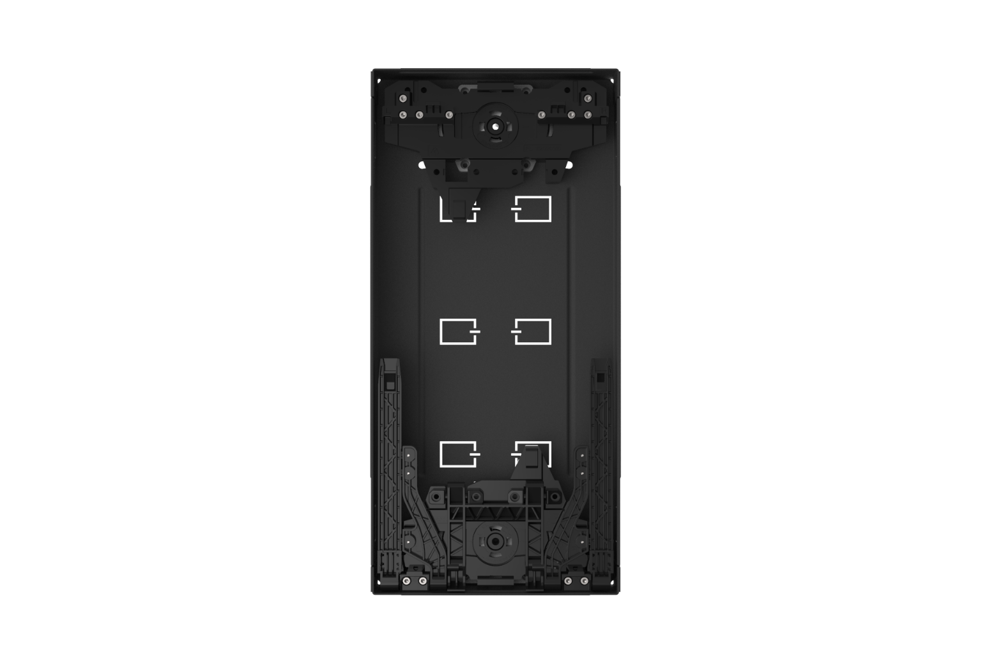
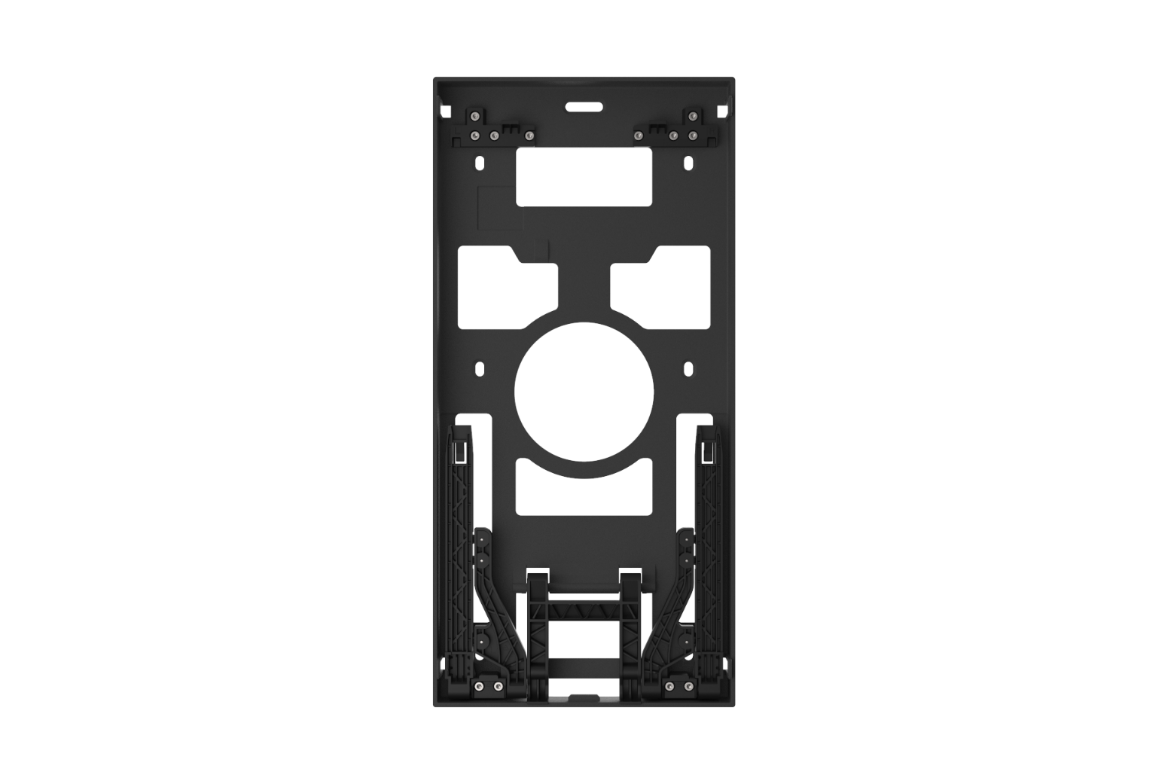
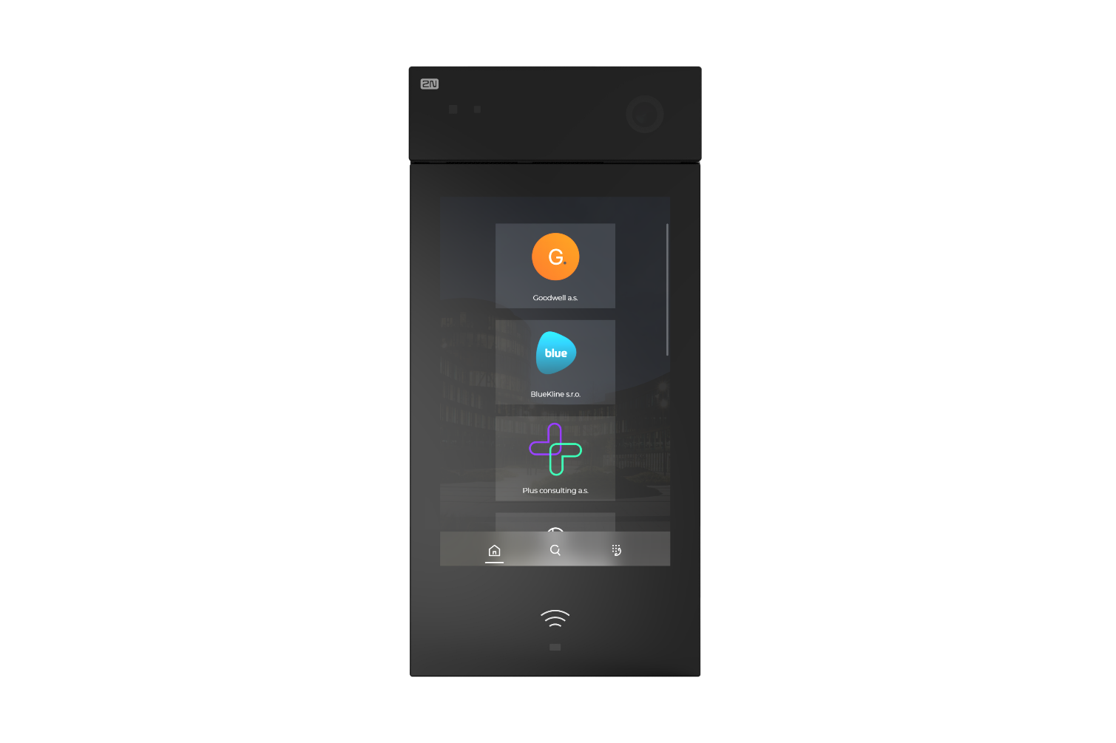
Part numbers
2N® IP Style
02407-001 (Supports secured cards; HID SE and HID Prox)
Flush mount box
02405-001
Surface mount box
02406-001

Slide 23
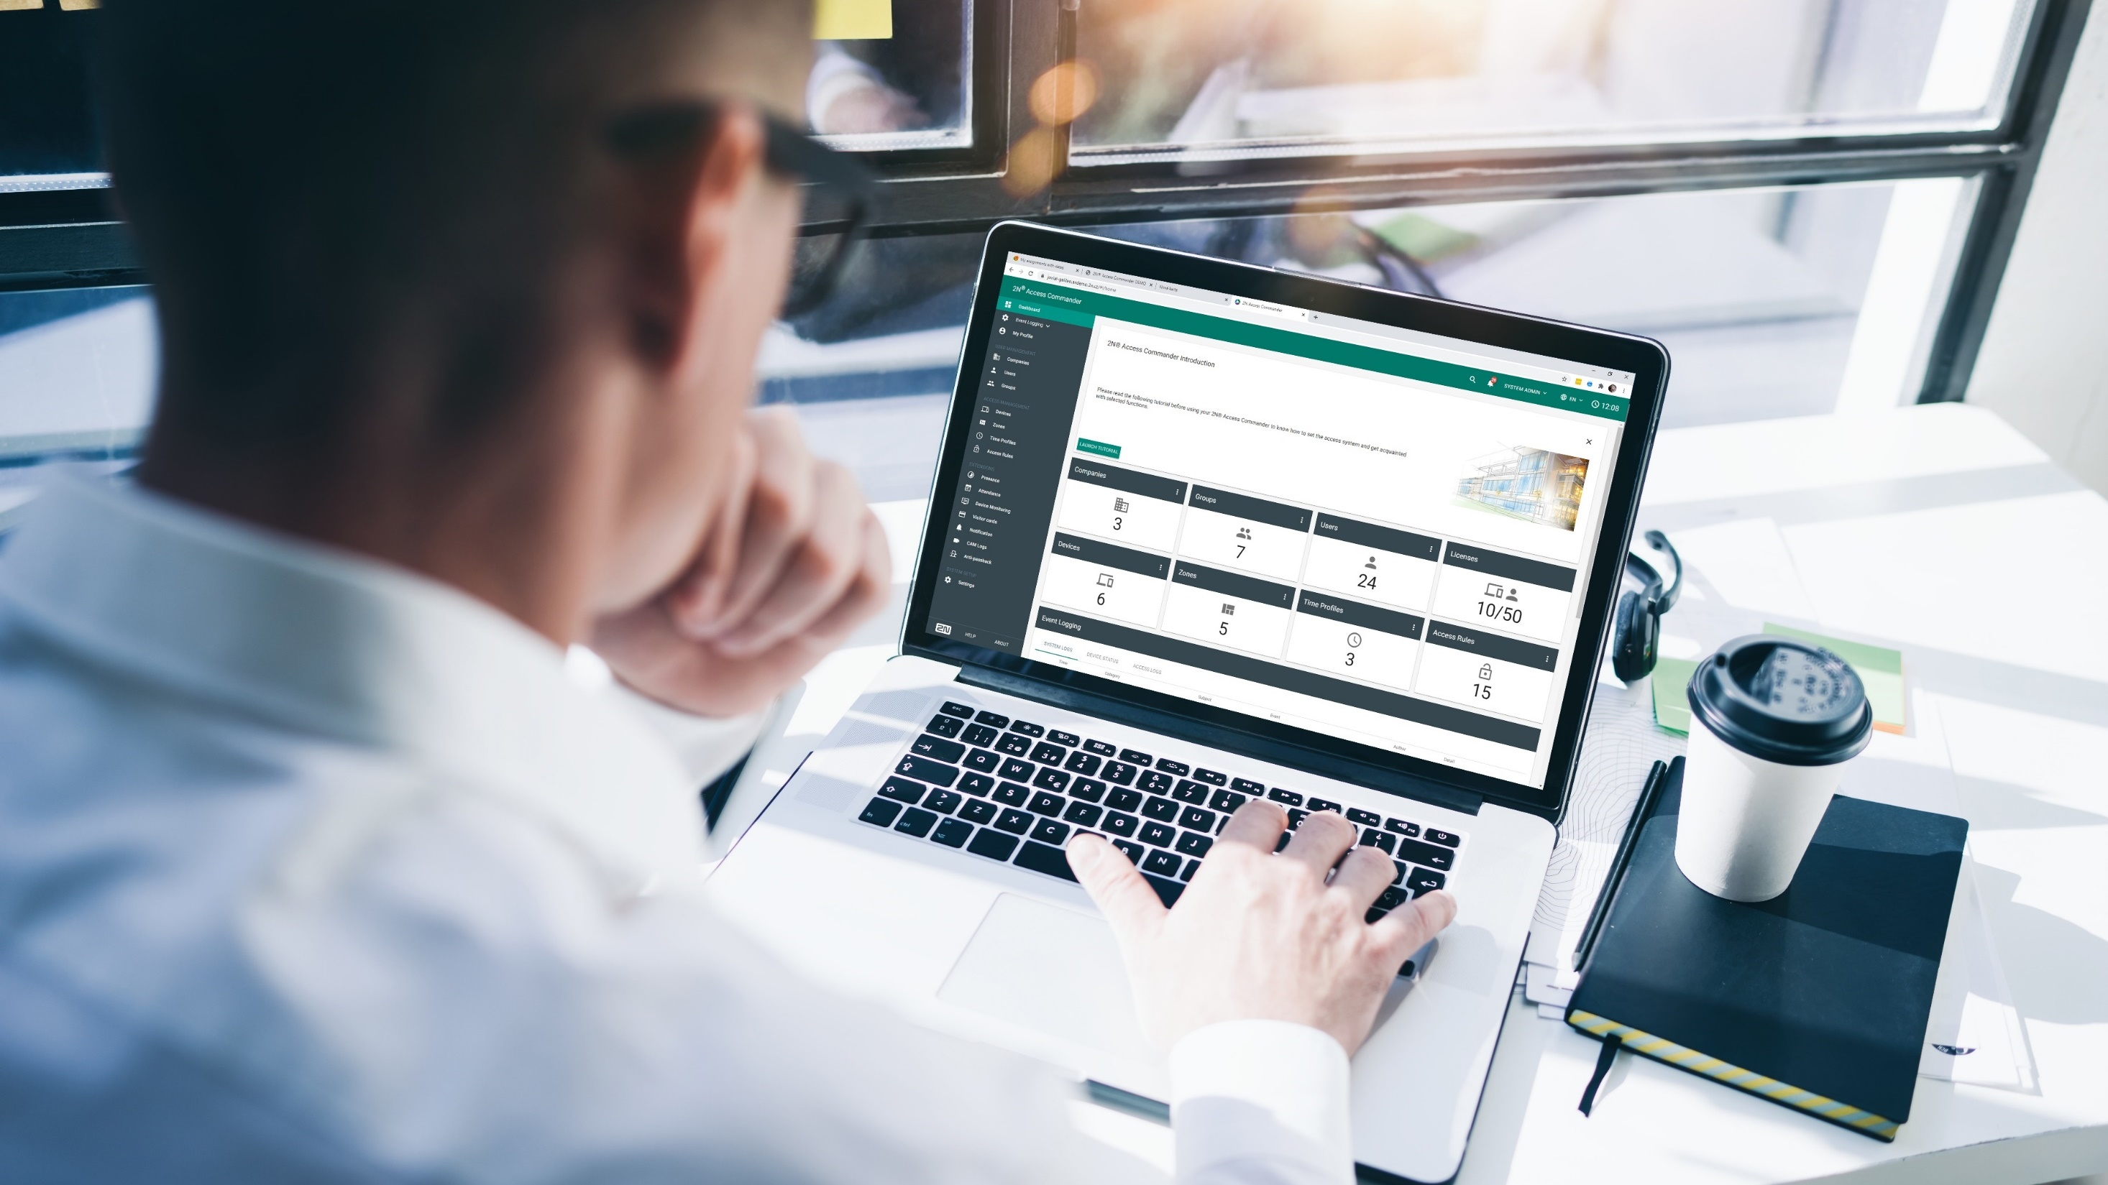
Options for configuration

Slide 24
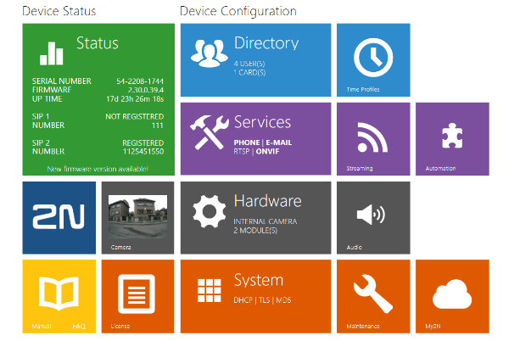
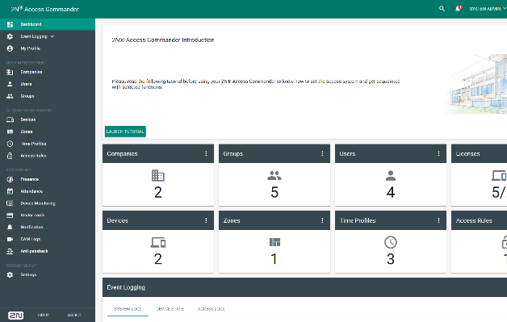
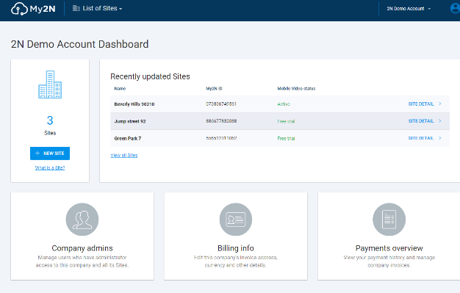
Choose the right configuration tool
Web interface of the intercom
Suitable for very small installations with up
to 2 or 3 devices – no bulk management
Web configuration interface allows you to config every single parameter of the intercom
2N® Access Commander
Tailored to SMB/SME type of installation with dozens of readers and intercoms
Professional access control SW for bulk management, monitoring and advanced feature settings
2N® Remote Configuration
Designed for a residential (MDU) projects with couple of intercoms, readers and many indoor answering units
Simple remote configuration without any network settings – saving on travel cost
Notes:
And how you can configure and administrate the reader? There are three ways:
For really small installations up to 2-3 readers you can use only a web insterface of the reader itself. It has an intuitive interface, however doesn´t support bulk configuration, however it allows you to setup basic access control.
For typical SME / SMB installation we recommend you to use Access Commander – professional software for access control management with many advanced features. My colleague Gareth will talk about this software later on.
If you decide to install the reader in residential building, we can recommend you to use 2N® Remote Configuration. With this cloud-based service you can configure the reader remotely and save on travel cost!

Slide 25
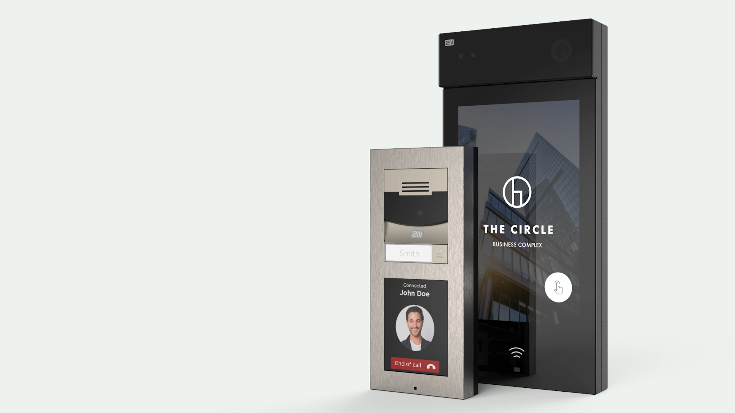
Product positioning
& comparisons

Slide 26



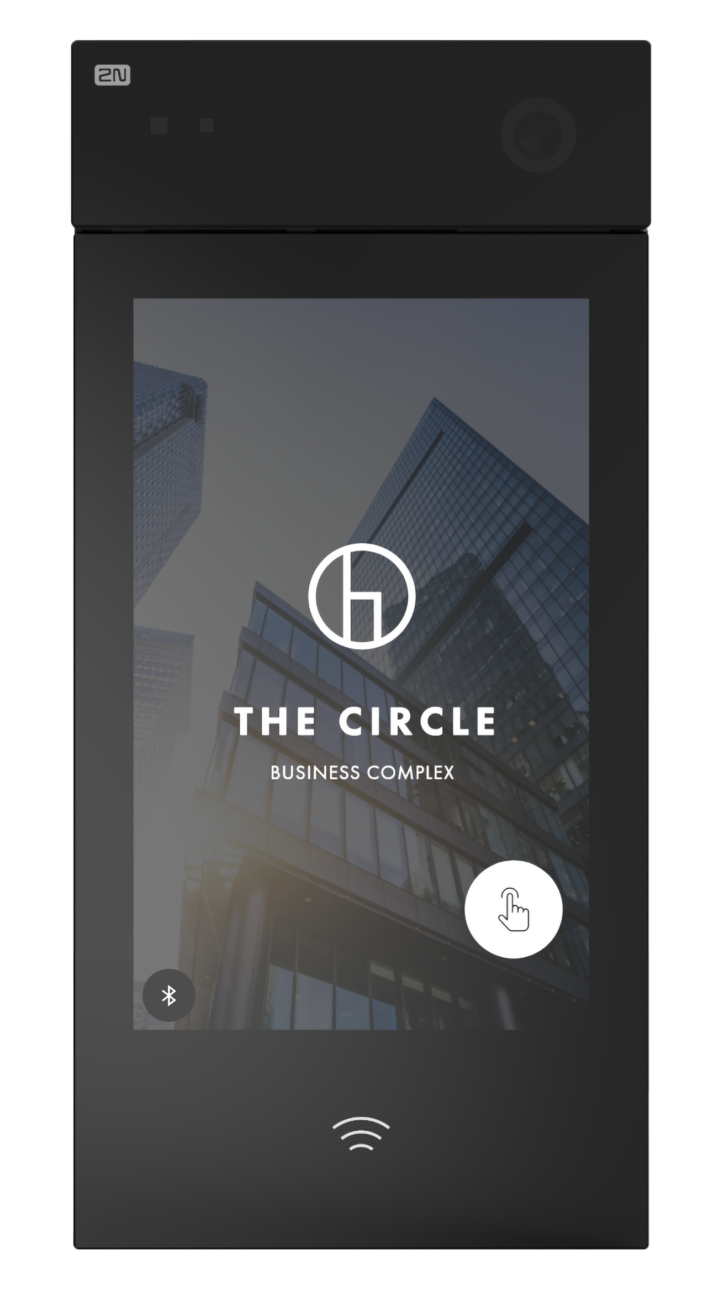
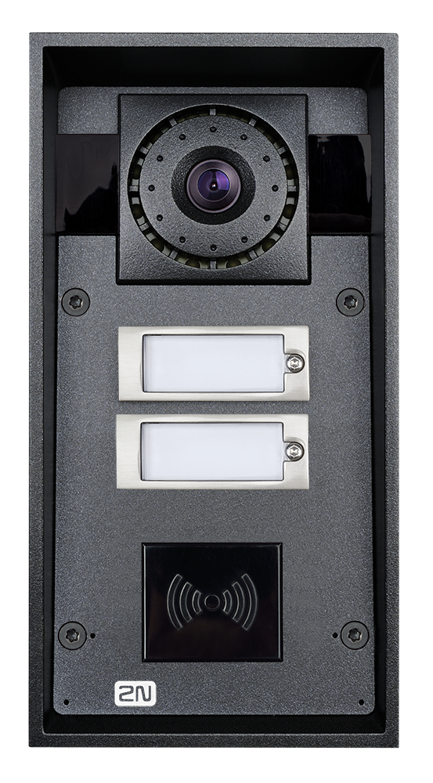
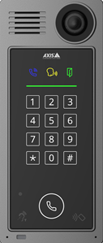
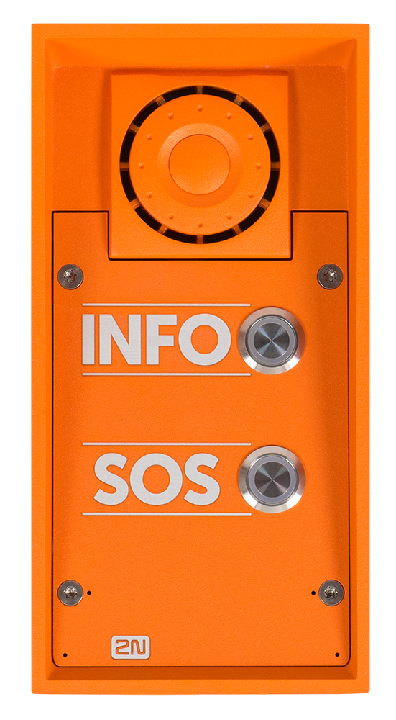



Office and residential buildings
Campuses, hospitals and public places
Critical infrastructure, transportation, industrial
Convenient access to the building
Designed for hundreds of contacts
Intuitive control for visitors
  Emergency communication with video monitoring and analytics
Building access for employees and visitors
Hear your visitors clearly with exceptional audio quality
Robust intercoms to withstand harsh and challenging conditions

Slide 27


  2N® IP Verso
  with Display and
  RFID & Bluetooth
  2N® IP Style
  Display resolution: 1280x800
  Camera: full HD (5MP), max. QHD (2560x1920)
  Modularity: no (all in one device; two part numbers)
  Vertical: high end (luxury) MDU and office
  Price: about 30% higher than 2N® IP Verso
  Display resolution: 320x214
  Camera: HD, video 640x480, JPEG 1280x960
  Modularity: fully modular (according to the customer’s need)
  Vertical: mid / high end MDU and office buildings

Slide 28

  IP intercom with excellent camera and exceptional display
  Easy to quote thanks to only two part numbers!
  Premium product that opens
  a door to new high-end projects

Slide 29
2N® IP Style
The best of IP intercoms and IP cameras in one device

